Slide 1
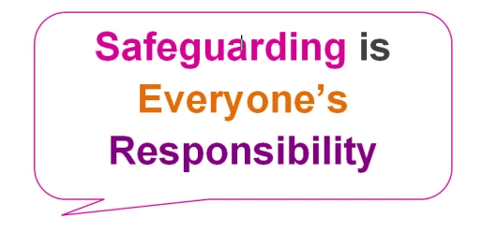
Adult Social Care Making Safeguarding Personal Thursday 18th March 2021
Working together to enable people to Live Well and Independently
in Telford and Wrekin
Notes:
Sarah Dillon Slide

Slide 2
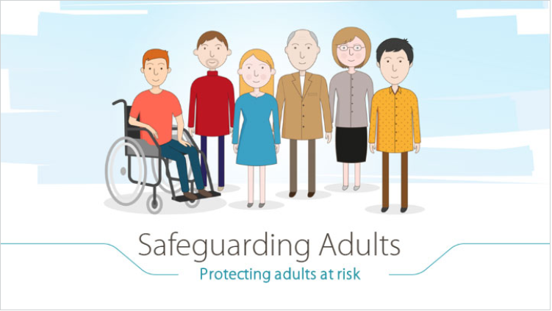
Making Safeguarding Personal
Aims/Objectives for today:
Why do we need to do MSP
What is MSP
How do we do MSP
How do we evidence MSP
Adult Social Care Practice Week

Slide 3
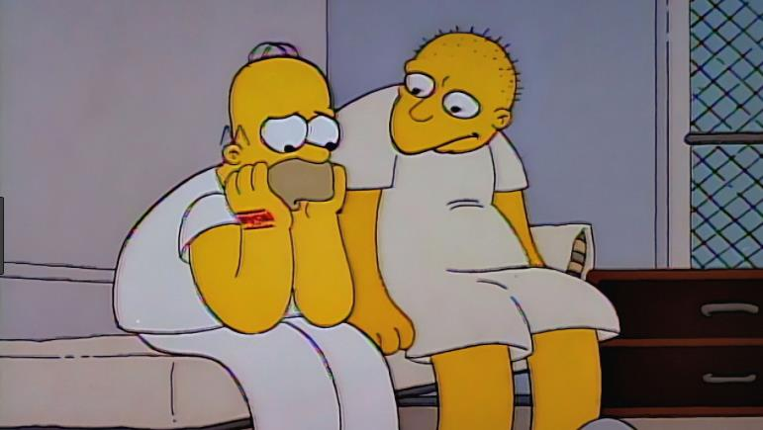
Making Safeguarding Personal
Put some ideas on the chat
What is MSP?!?!
Adult Social Care Practice Week

Slide 4


14.94 The objectives of a s42(2) enquiry:
• establish facts;
• ascertain the individual’s views and wishes and seek consent;
• assess the needs of the adult for protection, support and redress; and,
protect from the abuse and neglect, in accordance with the wishes of the adult;
• make decisions as to what follow-up action should be taken with regard to the person responsible, or the organisation, for the abuse or neglect.
enable the adult to achieve resolution and recovery
Adult Social Care Practice Week

Slide 5

Making Safeguarding Personal Toolkit
Making Safeguarding Personal toolkit
The practice toolkit handbook guides you through the best approach and effective application of safeguarding with a range of helpful tools and practice based case examples.
https://www.local.gov.uk/msp-toolkit
Adult Social Care Practice Week

Slide 6
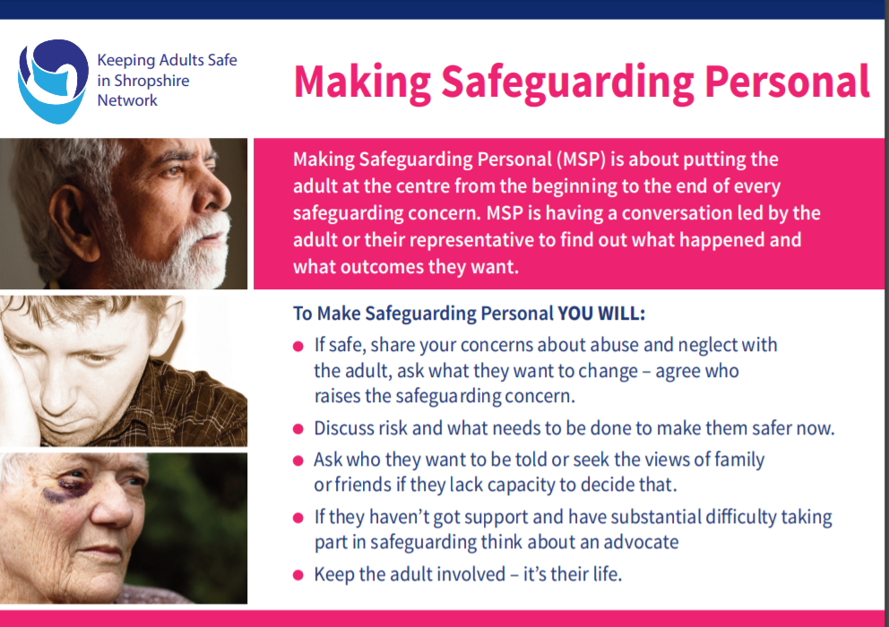
Keeping Adults Safe in Shropshire Network (2019)
Adult Social Care Practice Week

Slide 7
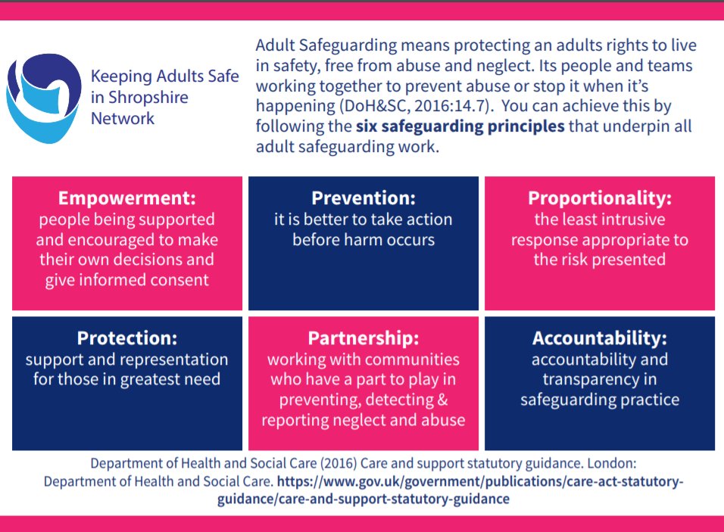
Statutory Safeguarding Principles
Empowerment Prevention Proportionality
Protection Partnership Accountability
Adult Social Care Practice Week

Slide 8

Making Safeguarding Personal
Podcast Episode 2 – MSP and a Co-Produced Conversation
https://soundcloud.com/rip-ripfa/sets/busting-myths-that-surround-making-safeguarding-personal/s-4nukW
Adult Social Care Practice Week

Slide 9
Making Safeguarding Personal
“is about having a conversation […], a co-produced conversation where I might say what I think MSP is and ask somebody I am working with about what they want to happen, about their journey, about their wishes, about their feelings, about their concerns, about their issues. Essentially, what they want out of the conversation and a series of conversations. What it isn’t about is stopping there, because I may also have ideas about what it is important that we explore, that may be to do with risk, it may be to do with needs, to do with rights, or finding out something about the person that I am working with that enables me to more appropriately respond to what they are saying and what they are asking for. A two way conversation rather than a one way conversation”.
(Hardy and Preston-Shoot, 2020)
Adult Social Care Practice Week

Slide 10
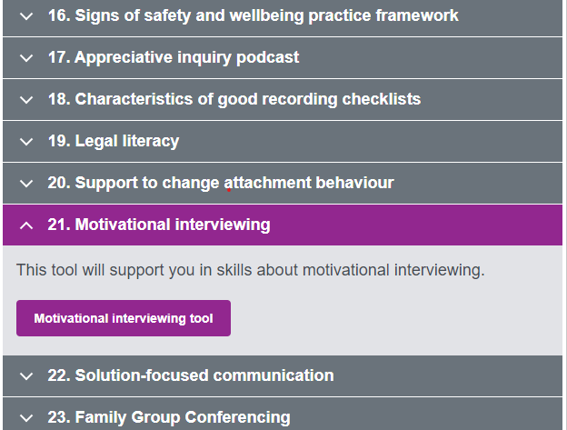
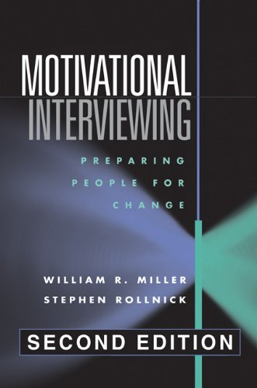
Making Safeguarding Personal
MSP Toolkit
Adult Social Care Practice Week

Slide 11


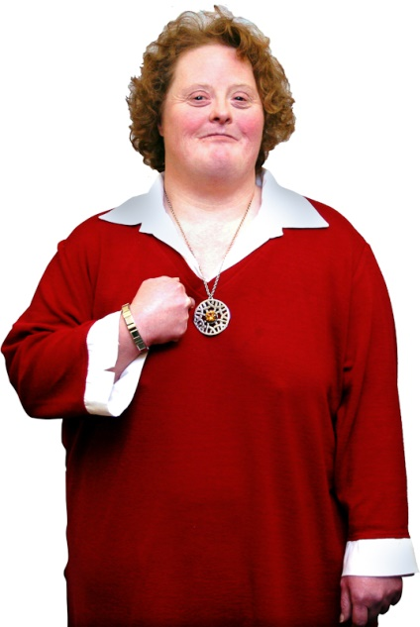
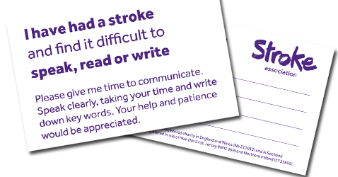
Communication
Time
Place
Space
Communication Aids
Personalised communication such as interpreters or British Sign Language (BSL) interpreters
Time: Best time of day to have a conversation with the adult?
Place: Best place to have a safeguarding conversation with the adult?
Adult Social Care Practice Week

Slide 12

Professional Curiosity
“asking questions that give and solicit information without being intrusive or making the [adult] feel threatened. These should be open-ended and allow for additional probing”
Thacker et al 2019
Adult Social Care Practice Week

Slide 13
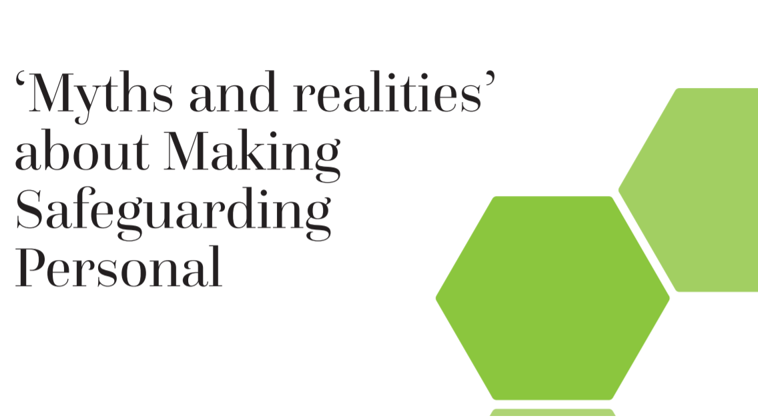
https://www.local.gov.uk/sites/default/files/documents/25.144%20MSP%20Myths_04%20WEB.pdf
Adult Social Care Practice Week

Slide 14
MSP – Myths and Realities
Statement – is it a myth
If you do Making Safeguarding Personal and don’t bring perpetrators to justice because the person doesn’t want action, they will go on and abuse again
Yes – it is a myth
No – it is not a myth
Adult Social Care Practice Week

Slide 15
Statement | Myth
If you do Making Safeguarding Personal and don’t bring perpetrators to justice because the person doesn’t want action, they will go on and abuse again. | In reality: Making Safeguarding Personal stops abuse and neglect.
Use relationship and communication skills to work with people so that they understand the implications of their decisions. Use legal literacy and fulfil your duty of care and public interest to ensure that anyone who could abuse others is properly and appropriately dealt with, so that these risks don’t occur again.
Adult Social Care Practice Week

Slide 16
MSP – Myths and Realities
Statement – is it a myth
Once we have referred a concern to the Local Authority, then it is over to them to investigate.
Yes – it is a myth
No – it is not a myth
Adult Social Care Practice Week

Slide 17
Statement | Myth
Once we have referred a concern to the Local Authority social services, then it is over to them to investigate. | In reality: : Safeguarding is everyone’s responsibility.
Working in partnership with the person raising the concern or making a referral and other people who can contribute, as well as the individual themselves, is critical to safeguarding adults. Safeguarding is not just about passing information on and ‘passing the buck’ but actively taking responsibility for things being done right.
Adult Social Care Practice Week

Slide 18
MSP – Myths and Realities
Statement – is it a myth
It’s not possible to use an MSP approach if people lack mental capacity for some decisions.
Yes – it is a myth
No – it is not a myth
Adult Social Care Practice Week

Slide 19
Statement | Myth
It’s not possible to use an MSP approach if people lack mental capacity for some decisions. | In reality: Making Safeguarding Personal is for everyone, including people who lack mental capacity.
MSP is an approach to safeguarding for everyone, regardless of mental capacity. Use advocates, ask people who know them what they might have wanted or preferred; get an idea of what outcomes they would have wanted. Work to the principles of the MCA (2005); make best-interests decisions about specific safeguarding risks, take into account what the adult would have preferred/wanted, find ways to obtain this information from family, friends, care or health workers etc.
Adult Social Care Practice Week

Slide 20
MSP – Myths and Realities
Statement – is it a myth?
Making Safeguarding Personal is just a chat over a cuppa.’
Yes – it is a myth
No – it is not a myth
Adult Social Care Practice Week

Slide 21
Statement | Myth
Making Safeguarding Personal is just a chat over a cuppa’ or ‘that MSP thing.” | In reality: Making Safeguarding Personal is about safeguarding practice and culture change.
MSP requires a change in our culture and practice of safeguarding. Moving from seeing safeguarding as getting through a process, to joining the parts of the system that can support the person and work together with that person. It requires leadership; cultural change; staff support and development; engaging with people and across partnerships; promoting the values and principles that are set out in Human Rights Act (1998), Care Act (2014), Mental Capacity Act (2005) etc.
Adult Social Care Practice Week

Slide 22
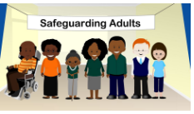
Making Safeguarding Personal
MSP is ‘just a cuppa’
https://soundcloud.com/rip-ripfa/sets/busting-myths-that-surround-making-safeguarding-personal/s-4nukW
Adult Social Care Practice Week

Slide 23
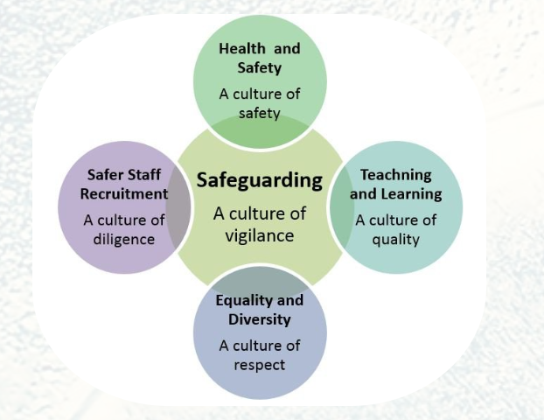
Making Safeguarding Personal
Episode 6 - Safeguarding is “Everyones Business.” https://soundcloud.com/rip-ripfa/sets/busting-myths-that-surround-making-safeguarding-personal/s-4nukW
Adult Social Care Practice Week

Slide 24
What needs to be considered when supporting Frank in terms of Making Safeguarding Personal and the principles of safeguarding?
Things we know about Frank:
87 years old, white, British
Previous S42 2020 in relation to coercive and controlling behaviour by grandson Nigel; police involvement not progressed
Frank (tenant) lives in rented accommodation with his grandson Nigel. Nigel works full time.
Nigel states he provides housework, laundry, meals and shopping. Frank pays all utilities.
Frank as result of fractured hip has reduced mobility and resulting care and support needs around personal care and daily living
receives x4 care calls Sat, Sun; Nigel reports he provides the care identified on support plan on week days.
District nurses visit weekly
Frank is unable to access the community
Frank is an unassuming, quiet person. Has difficulty challenging people in his life
Frank has disclosed that he has been psychologically and physically abused over a period of time by his grandson Nigel who has lived with him in a caring role for 4 years. Concern reported in by his sister. Meets S42 eligibility. Strategy Discussion held, immediate protection plan put in place. Strategy Meeting arranged. Proceed to Section 42 Enquiry.

Slide 25
Case Study - MSP
Empowerment: have conversations to explain the process, explore the persons wishes, feelings and what outcomes they would like. Consider advocacy and legal literacy
Partnership: utilise a multi agency approach and family (if supportive) to promote conversations and protection. Proportionate actions to prevent further risk
Use professional curiosity and relationship-based practice to ensure that someone isn’t pushing you away because they are coerced or controlled.
MSP requires a series of conversations with people and for practitioners to have (enough) professional curiosity to understand what is going on. Make sure the conversation has fully explored unwise decisions
Accountability: because of risk there may be times when outcomes can’t be person centred; be open and transparent why and explain the process.
Adult Social Care Practice Week

Slide 26
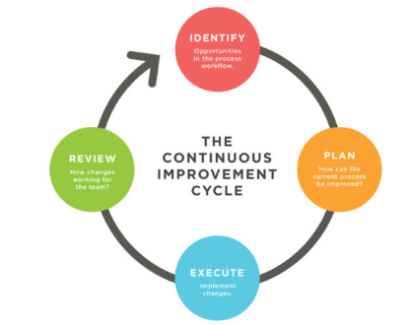
How do we evidence MSP?
Case records: case notes; contacts; strategy discussion; strat meetings
S42: reports/statistics eg outcomes, conversation with alleged victim, consent
SG competency framework
Supervision
Peer Supervision Meetings
Training, Team Meetings.
File Audit
MSP Evaluation Tools
Adult Social Care Practice Week

Slide 27

Making Safeguarding Personal
Put the adult at the centre of safeguarding, from the beginning to the end of every concern
If safe, share your concerns about abuse with the adult
Ask what they want to change – agree who raises the safeguarding concern
Discuss risk and what needs to be done to make them safer now
If they haven’t got support and have substantial difficulty taking part in safeguarding think about an advocate (duty)
Ask who they want to be told or seek the views of family or friends if they lack capacity to decide that
Have conversations led by the adult to find out what happened and what outcomes they want
Keep the adult involved – it is their life!
Keeping Adults Safe in Shropshire Network (2019)
Adult Social Care Practice Week

Slide 28

After Session Resources
https://www.local.gov.uk/msp-toolkit
https://www.local.gov.uk/sites/default/files/documents/25.144%20MSP%20Myths_04%20WEB.pdf
https://www.youtube.com/watch?v=hPYoeZYaVm4
Thacker H, Anka A, Penhale B. (2020) Professional curiosity in safeguarding adults: Strategic Briefing. Totnes: Research in Practice. https://www.researchinpractice.org.uk/adults/publications/2020/december/professional-curiosity-in-safeguarding-adults-strategic-briefing-2020/
Adult Social Care Practice Week

Slide 29
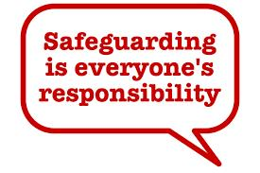
Final Thought
Regardless of role, title or locality
Safeguarding goes through your practice, like semi skimmed through tea
It’s not about blame, or denying accountability
Rather making sure it is everyone’s responsibility
And even if you don’t know your pipot from your section 42
Making safeguarding personal, is something everyone can do
Andrew Wright 2021
Adult Social Care Practice Week

