Slide 1

The Armed Forces Covenant Duty
Smita Mehta, Ministry of Defence, Covenant Team
Notes:
.

Slide 2

Option 1: A promise of preferential treatment for the Armed Forces community.
What is the Armed Forces Covenant?
Option 2: A promise that the Armed Forces community should be treated fairly.
Option 3: An agreement with the Armed Forces community to be taken care for life.
Notes:
The correct answer is Option 2.

Slide 3

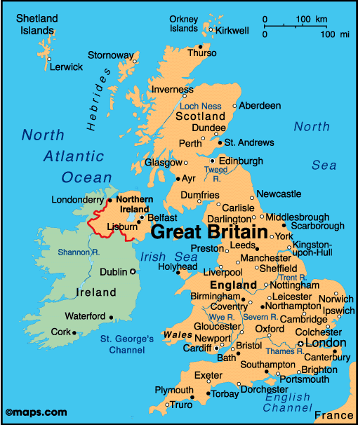


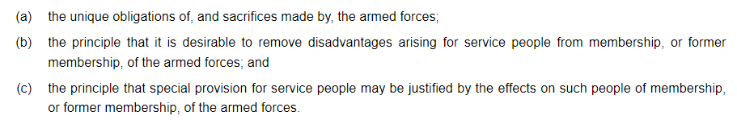
Notes:
The Armed Forces Covenant was created in 2011, and it is a promise by the nation ensuring that those who serve or who have served in the Armed Forces, and their families, are treated fairly and will not be disadvantaged by their military service. It also allows for special provision when justified for those who have sacrificed the most due to service, such as the bereaved and injured.
The Armed Forces Covenant applies throughout the UK and is delivered across all sectors of society. As such, its implementation is shaped by local and regional factors and jurisdictions to optimise local support. In central Government, the MOD is the lead Department for the Covenant. As many of the levers for supporting the Armed Forces Community sit with other Government Departments, the Devolved Administrations and Local Authorities, MOD works closely with them and others in the public, charitable and private sectors to deliver the Covenant. Local Government play a key role in delivering the Covenant on the ground. To date, every local authority in Great Britain have made pledges to support the Armed Forces Community. The Covenant is also delivered across businesses to promote fairer outcomes for the Armed Forces community.
The Covenant is focused on preventing the disadvantages that our Armed Forces Community can face when accessing goods and services. For instance, this year, the MOD’s Education Support Fund provided £2 million worth of grants to 75 schools across the UK to help them mitigate the impact of mobility and separation on Service children and their families.
Continue on the next page.

Slide 4
Notes:
4. Covenant delivery is supported by the £10M per year Armed Forces Covenant Fund administered by the Armed Forces Covenant Fund Trust, an independent grant-making body with charitable status. In 2020/21, the Trust awarded over £25m to over 700 projects. Its funding programmes for 2020/21 included an additional £6M fund for Armed Forces charities and Community Interest Companies supporting service personnel, Veterans and their families affected by Covid-19.
5. Over the last eleven years, the Covenant has led to many activities and initiatives which have contributed to improvements in the lives of the Armed Forces Community.
6. Last year 11 new AF Champion Leads were appointed across Jobcentres, responsible for supporting veterans into work, while the Service Pupil Premium funded around 80,000 students.

Slide 5
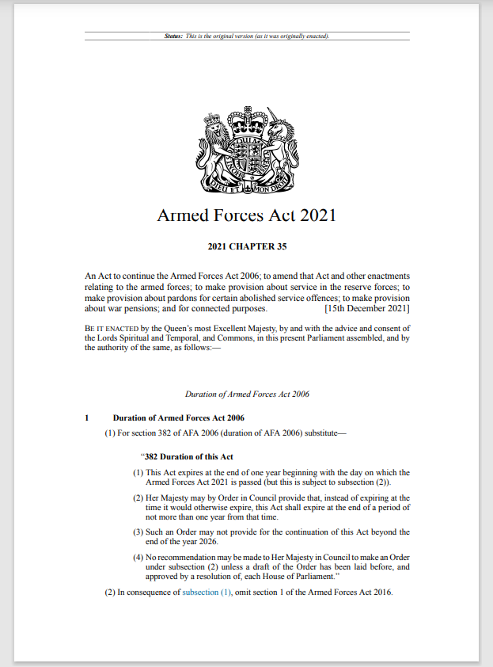
The Covenant Duty
Notes:
The Government, through the Armed Forces Act 2021, has strengthened the Covenant by creating an Armed Forces Covenant Duty, to better prevent the disadvantage faced by the Armed Forces community due to the unique nature of service life.

Slide 6




Why do we need it?
To build on the good work and delivery in support of the Armed Forces Community.
Members of the Armed Forces Community are still facing disadvantage in accessing public goods and services.
There remains a disparity in awareness of the Covenant and the issues that the AF Community face around the country.
To improve the Armed Forces’ lived experience, by increasing awareness of disadvantages they can face and how they can be resolved.
Notes:
Why do we need the Covenant Duty?
It is to build on the good foundation already there and to better support our Armed Forces community.
But there is still more work to do as some still do face disadvantages when accessing public services. Often caused by a lack of awareness among service deliverers and policy makers of the unique obligations and circumstances facing the Armed Forces community.
There remains a disparity, both in terms of awareness of the Covenant, and issues that the Armed Forces community face as they move around the country.
By increasing awareness, thought can be given to how they can be resolved and this will improve the lived experience of the Armed Forces community.
It is important to note that when we talk about disadvantage, we mean in comparison with the local population and their experience of accessing local services. In addition, any disadvantage must relate to an aspect of service life for it to be relevant to the Duty. For example, Service families may be unable to take holidays, or spend time together, during normal school holiday periods and Service children might find they have limited time to spend with their serving parent(s) if the parent can only return home during term-time. The Service family might therefore ask the school for permission to take a holiday during term-time. By embedding an understanding of these disadvantages in public sector decision-making, through the statutory duty to have due regard to the Covenant, this legislation will help improve overall delivery of public services in relation to the Armed Forces community.

Slide 7
What is the Covenant Duty?
A statutory duty on specific bodies in the areas of Healthcare, Housing and Education
to pay due regard
to the principles of the Armed Forces Covenant.
For example: in healthcare, bodies such as the National Health Service​ dealing with healthcare waiting list policies.
For example: in housing, bodies such as Local Authorities​ dealing with the allocation of social housing.
For example: in education, bodies such as schools and academies​ dealing with the school’s admissions criteria.
The bodies subject to the Duty are expected to consciously consider the Covenant when developing, delivering and reviewing policies and decisions which may impact the Armed Forces Community.
Notes:
The Covenant Duty is a statutory duty on specific bodies in the areas of healthcare, housing and education to pay due regard to the principles of the Armed Forces Covenant.
Examples in healthcare – waiting list policies; in housing – allocation of social housing; education – school’s admission criteria.
The bodies in scope of the Duty are expected to consciously consider the Armed Forces Covenant when developing, delivering, reviewing policies and making decisions which may impact the Armed Forces community.
It does not mandate out-comes but it means that the Armed Forces community are taken into consideration and given a fair hearing. The Duty is flexible so local areas can meet needs of their local population.

Slide 8
In-scope bodies (England)
Housing
Local authorities
Healthcare
NHS Commissioning Board (NHSE)
Clinical Commissioning Groups (and their successors)
NHS Trusts/Foundation Trusts
Local authorities
Education
Governing bodies of maintained schools
Non-maintained special schools
Proprietors of academies
Governing bodies of further education institutions & special post-16 institutions
Local authorities

Slide 9
In-scope functions (England)
Housing
Allocation of social housing
Tenancy strategies
Homelessness
Disabled Facilities Grants
Healthcare
Provision of services
Planning and funding
Co-operation between bodies and professionals
Education
Admissions
Attainment
Wellbeing
Transport
Attendance
SEND
Service Pupil Premium

Slide 10
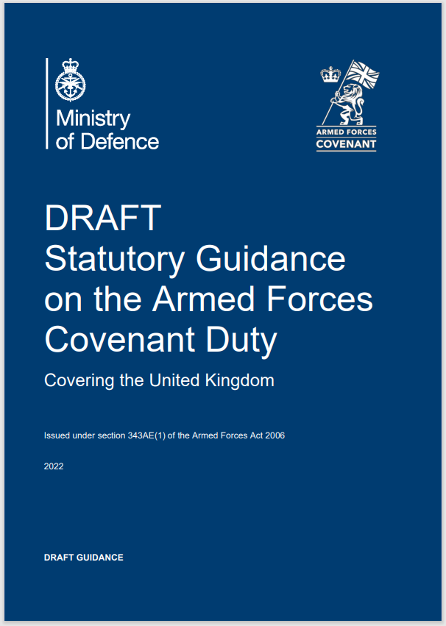
Covenant Duty Statutory Guidance
Why a Statutory Guidance document?
To improve the Armed Forces’ lived experience, by increasing awareness of disadvantages they can face and how they can be resolved.
The Armed Forces Act provides for a Statutory Guidance document to be published.
To increase understanding of, and compliance with, the Duty, by creating a legal requirement for bodies to have regard to it.
To explain everything you need to know about the new Duty, in plain English (and Welsh).
Notes:
Why a Statutory Guidance document?
The Armed Forces Act provides for a Statutory Guidance to be published, and it has an implied expectation that one will be published.
In fact the organisations in scope of the Duty are legally required to pay regard to this Statutory Guidance document, when carrying out the relevant activities.
And we need a document, focussed on the Duty, that explains what the law requires, and how it can be implemented in practice. The Armed Forces Act itself has to be written in legalese that can be hard to understand, so the Statutory Guidance hopefully provides the translation of the legal requirement into plain English.
And therefore, by creating a document that clearly explains what the law requires, and that the affected bodies are legally required to pay attention to, we should increase understanding of the Duty, and compliance with it.
And therefore, by increasing understanding of the Covenant, and how it can be applied in practice, and how disadvantages can be removed, we will hopefully achieve the ultimate aim, which is to improve the Armed Forces’ lived experience.

Slide 11
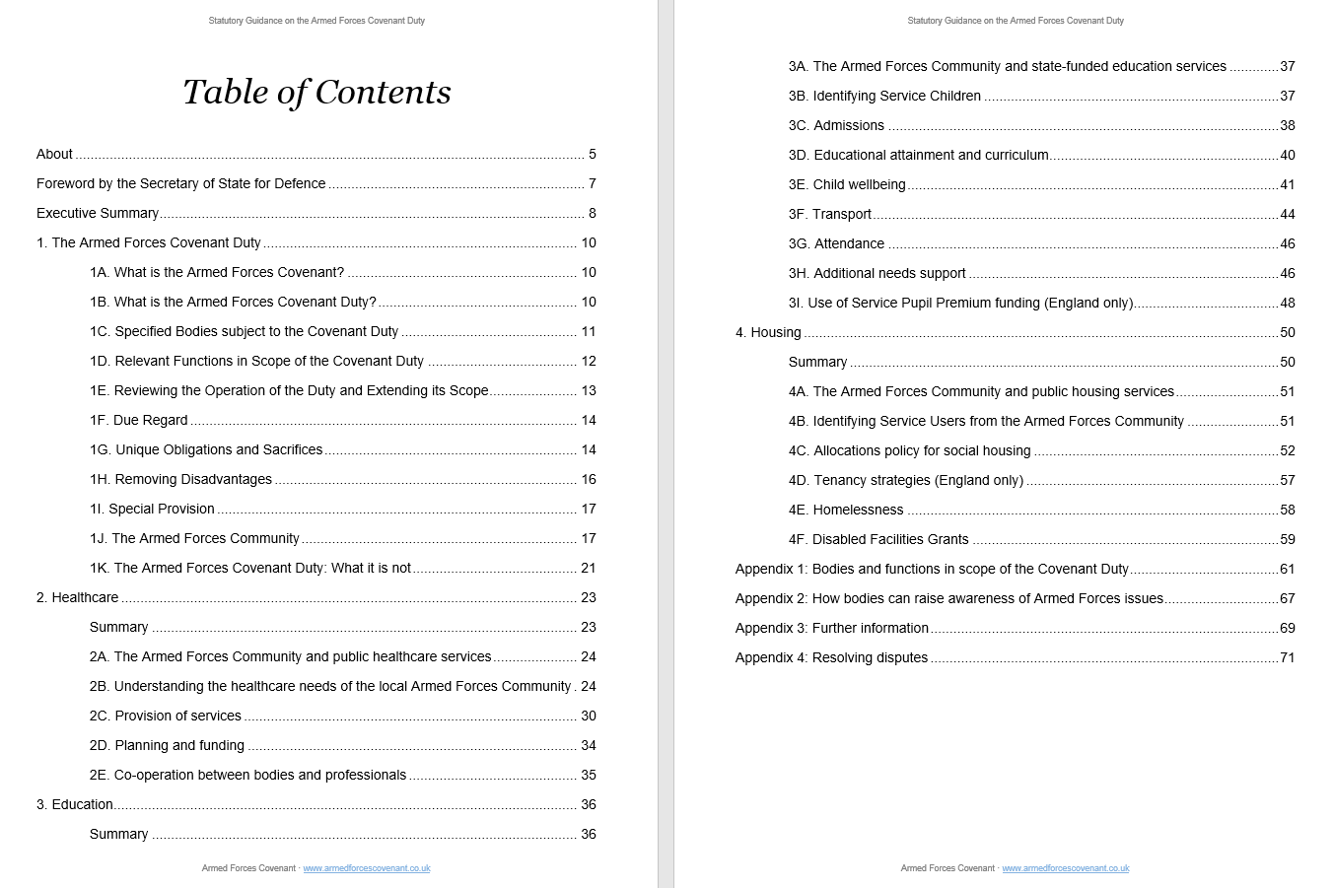
What is in the Statutory Guidance?
2-page Exec Summary
What is the Duty?
Who’s in scope & when?
Key terms
Application in the field of healthcare
Notes:
The first thing to highlight is there is a 2-page Executive Summary that summarises the Duty on a couple of sides.
Chapter 1 explains what Duty is, when it applies, who’s in scope & when, and explains the key terms, such as ‘unique obligations and sacrifices’, and who the Armed Forces community is, and so on.
Chapters 2, 3 and 4 then describe how it can be implemented in practice, in the three fields that are in scope – healthcare, education and housing. Chapter 3 is the chapter about education and chapter 4 is on housing.

Slide 12
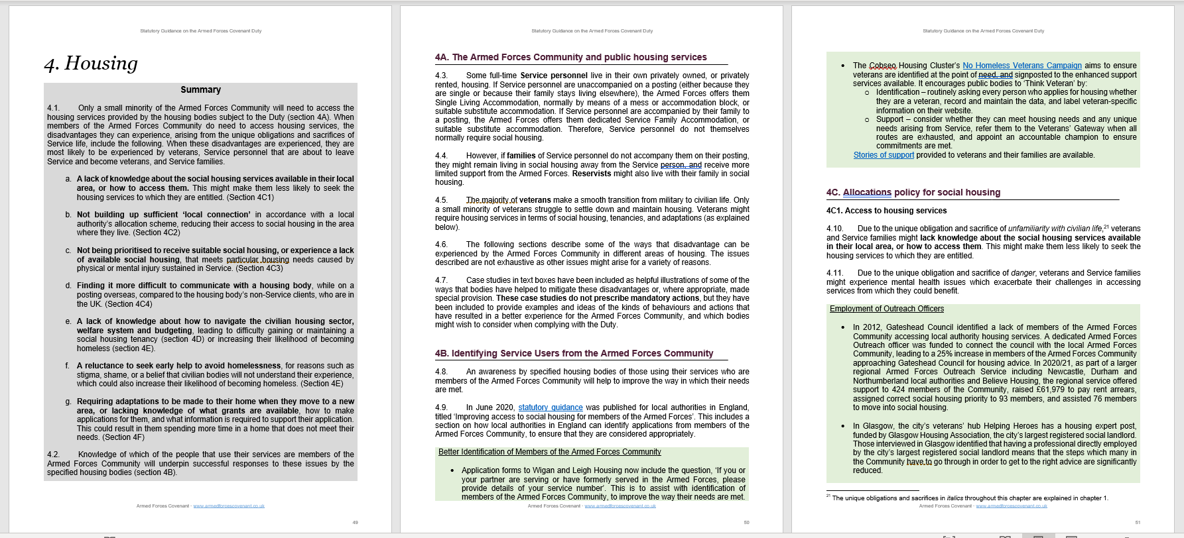
What is in the Statutory Guidance?
Context
Descriptons of disadvantages
Other relevant codes, legislation, etc
1-page summary of chapter
Descriptions of case studies to mitigate disadvantages or apply special provision
Notes:
HOUSING CHAPTER.
This is a screenshot of the first 3 pages of the Housing chapter.
First there’s a 1-page summary of the whole chapter.
Then the first section in the chapter provides background and context of how the Armed Forces community interacts with this area of public service provision.
Then the rest of the chapter contains 3 elements:
descriptions of disadvantages for the AF Community, that arise from Service life,
descriptions of case studies to mitigate these or apply special provision, and
links to other relevant codes, statutory guidances, and the like, if they refer to the AF

Slide 13

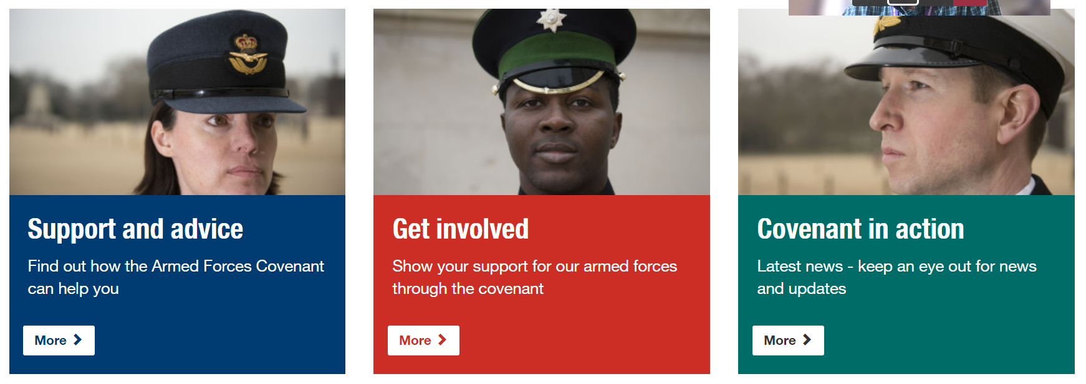




Other Support
Notes:
In addition to the Guidance, there is lots of other support available to help in-scope bodies implement this Duty.
The Covenant Annual Reports provide useful information on Covenant and examples of its implementation. It sets out major achievements and highlights remaining challenges and new commitments.
The Covenant website contains useful resources and tools. One of which includes the article we sent out to you before this event. The news brief can be found at the tab for latest news and includes useful links including one to the draft statutory guidance.
The Armed Forces Covenant Fund Trust Knowledge network shares good practice and knowledge of those who have received grants from the Covenant Fund Trust.
E-learning materials, Warwickshire County Council has created an e-learning programme which anyone can access via a link on the news brief and elsewhere on the Covenant webpages.
Ombudsman Guidance, for example the Local Government & Social Care Ombudsman has information on their webpages, there are other Ombudsman across UK.
Defence Relationship Management partners with organisations throughout the UK, helping them understand the value of signing the Covenant and building mutually beneficial partnerships with Defence. It provides support on employing members of the Armed Forces community.
And there are other organisations such as the Veterans Covenant Healthcare Alliance which will have information on the Covenant.

Slide 14
MOD’s Covenant Legislation Team
Name | Role
John Shivas | ● Team leader
Smita Mehta | ● Parliamentary handling ● Comms ● Liaison with Devolved Administrations
Mark Mitchell | ● Policy (who’s in scope of the Duty, when, etc) ● Statutory Guidance ● Liaison with other UK Government Departments
Patrick O’Brian | ● Covenant in the Community ● Liaison with local authorities
www.armedforcescovenant.gov.uk COVENANT-MAILBOX@mod.gov.uk

