Slide 1
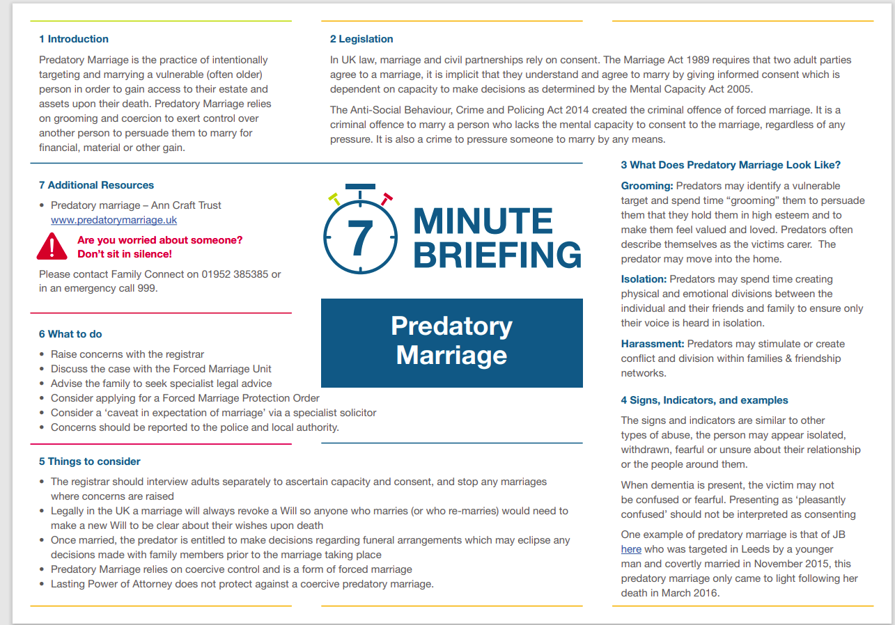

Slide 2
Watch the Predatory Marriage Seminar by Daphne Franks Justice for Joan hosted by Telford and Wrekin Safeguarding Partnership
Predatory Marriage Seminar by Daphne Franks Justice for Joan hosted by Telford and Wrekin Safegu - YouTube

