Slide 1



Family Carers
Carers Centre
Notes:
Introduction to the session the importance of working in partnership–
Amardeep and Ange, purpose of session to raise profile of carers needs, to ensure we understand the carers legislation and our duty of care to carers.

Slide 2


The Carers Centre
Who is a carer?
Anyone who supports and cares for a family member, friend or neighbour, without whom they could not manage due to age, disability or long term health conditions.

Slide 3
The Care Act - carers
The care act supports assessments for carers in their own right with the following eligibility criteria:
A Carer's eligibility is based on identifying and meeting 3 criteria:
Do the needs arise because the carer is providing necessary care and support?
Is the carer's physical or mental health affected or at risk of deteriorating, or are they unable to do things because of their caring role?
Because of their caring role is there a significant impact on the carer's wellbeing?
Notes:
- Amardeep

Slide 4

The Carers Centre
The ‘cost’ of Caring:
Carers save the British economy
£162 billion per year in unpaid care support

Slide 5

The Carers Centre
An estimated 26% of the UK adult population is providing unpaid care to an older, disabled or ill relative or friend – that is equivalent to one in four adults.

Slide 6

The Carers Centre
Through working together, and sharing expertise, we can all help adult and young carers in Telford & Wrekin to be better supported through their journey
What Do We Do?

Slide 7
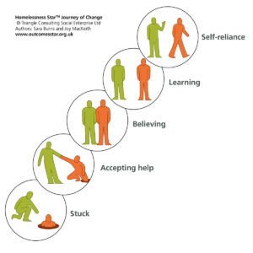
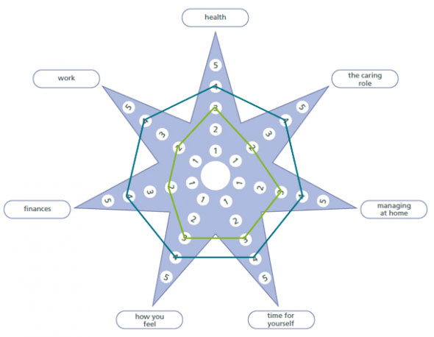
Intensive Support - Adults
As part of the intensive support, we offer we complete an outcome star with the carer.
These outcome stars enable the carer to have a visual tool to empower them to look at the areas of their lives that are good and those areas where they may need some more support. We have completed all our stars are collaboratively with the carer and them came up with an action plan of how to make small manageable changes.
The stars are always person centred aims to help them get to a position where their life and caring role is as good as it can be.

Slide 8
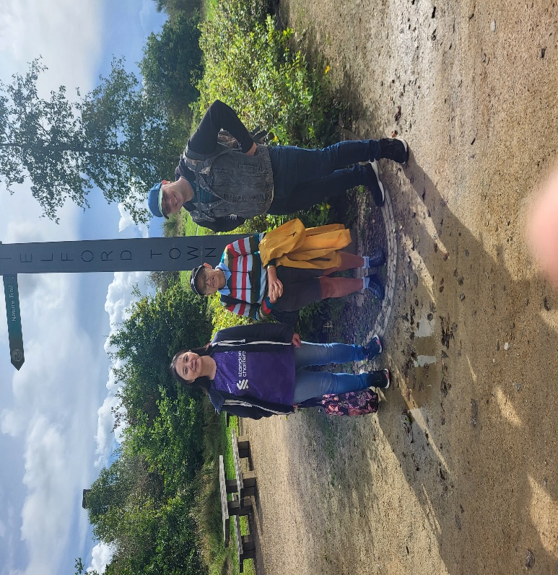
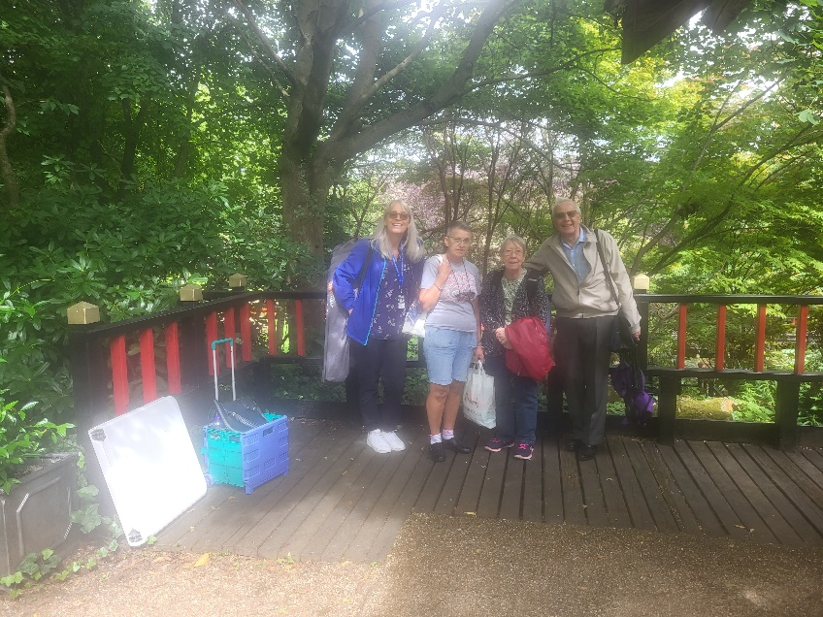
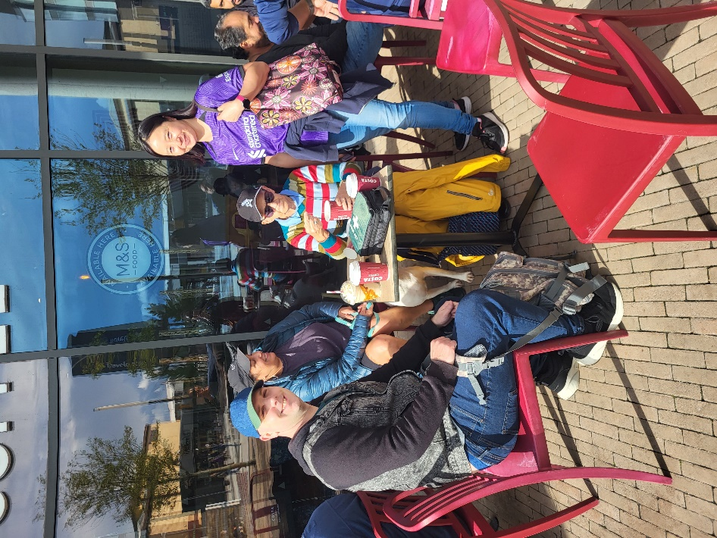


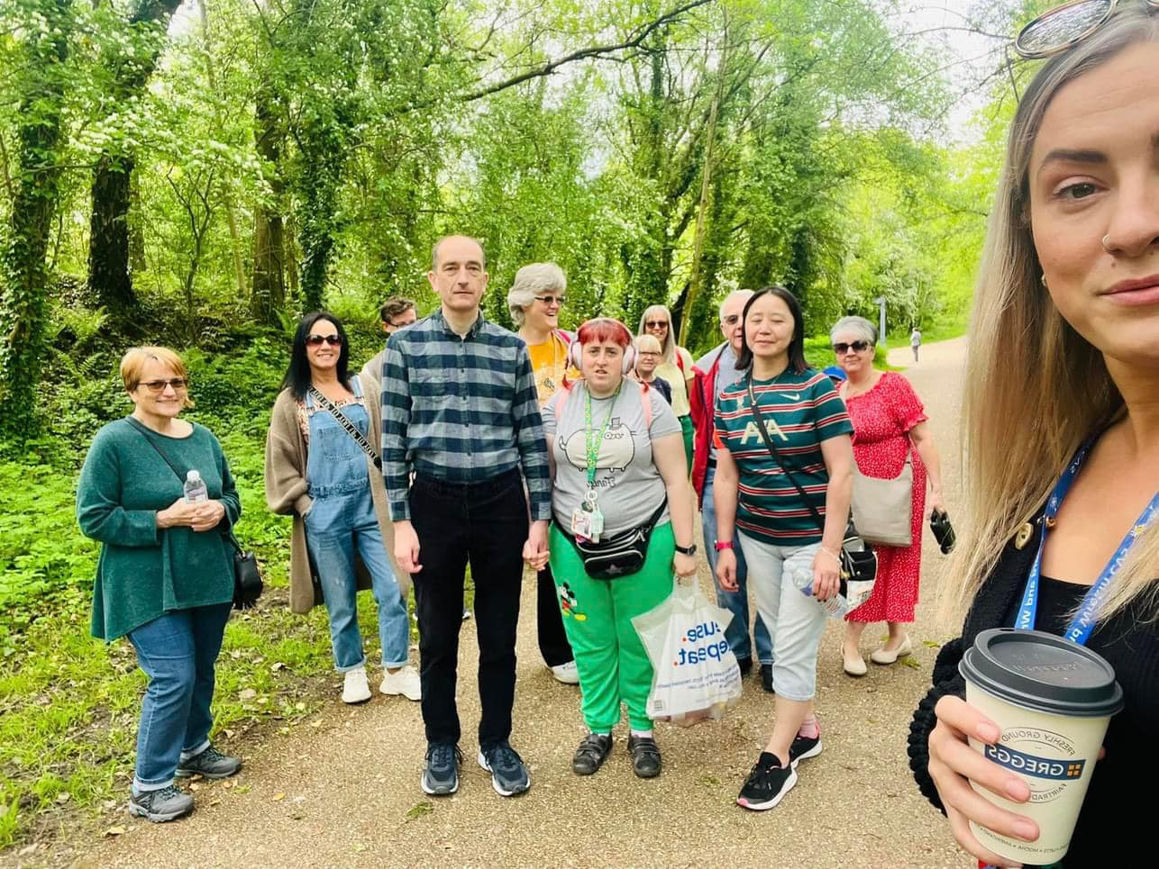
Wellbeing Groups and Activities
Carers Walks and Picnics

Slide 9

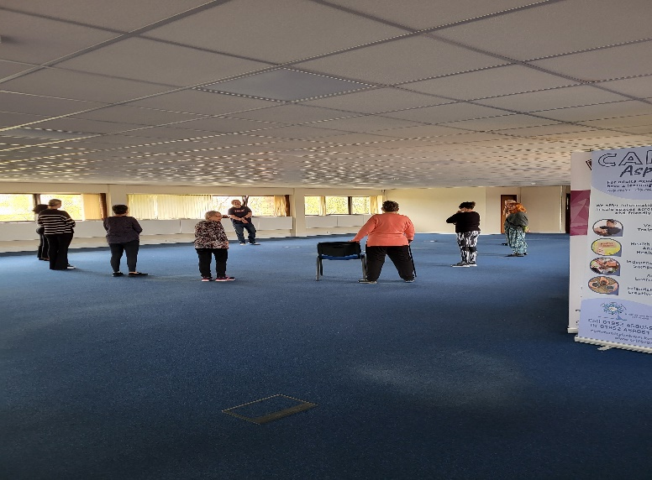
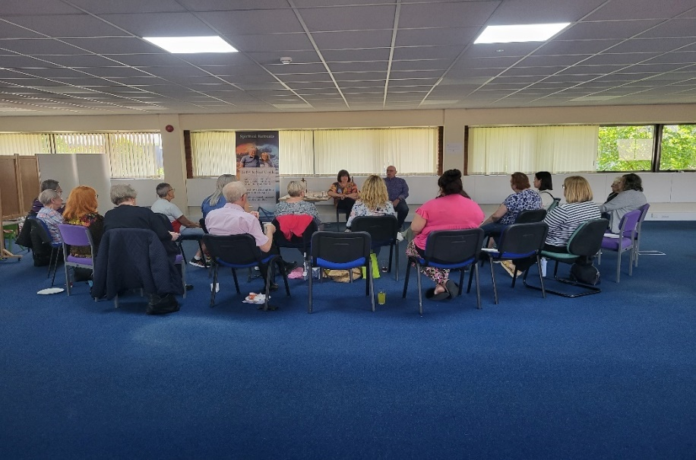
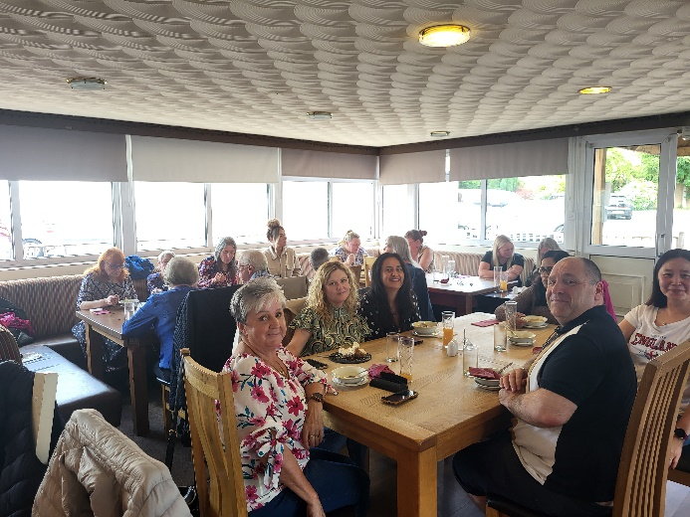
Wellbeing groups and activities
We have done Tai Chi sessions, a meal out we had a medium and mindfulness couple in.
We are always trying to give our carers a range of activities and events to cater for all.
We ask their views, feedback and ideas and try to facilitate these as much as we can.

Slide 10

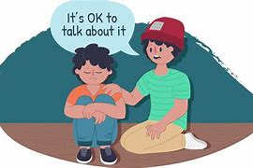
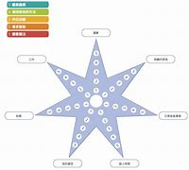


Our offer to Young Carers
Young carers assessment
Outcome Star- To identify the young persons need
1-1 support
Youth club
Holiday activities
Outreach work
Mind of My Own app

Slide 11
Young carers Star
Physical Health
Where you live
Being Safe
Relationships
Feelings and behaviors
Friends
Confidence & Self-esteem
Education and Learning

Slide 12
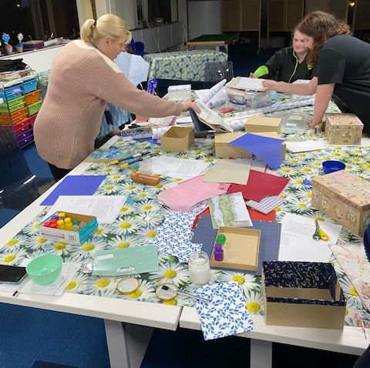
Youth Club

Slide 13
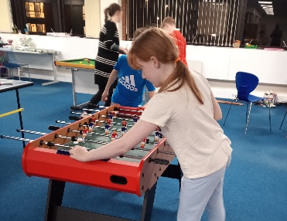
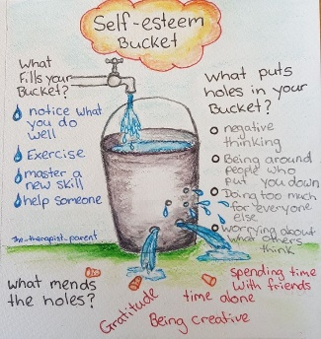
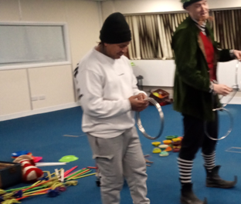
Primary & Secondary
Sport Coaching
Wellbeing
Mentoring
Skill building

Slide 14
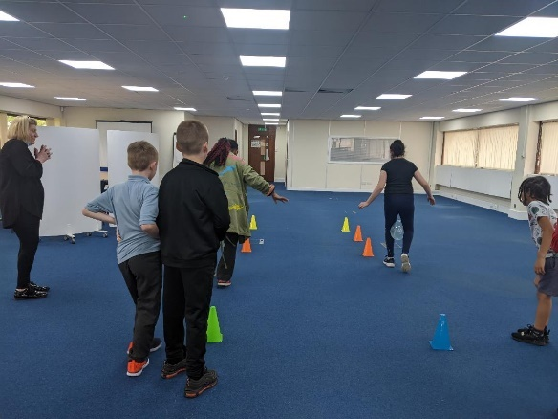
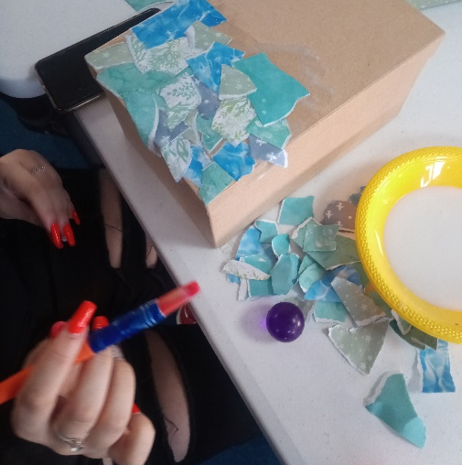
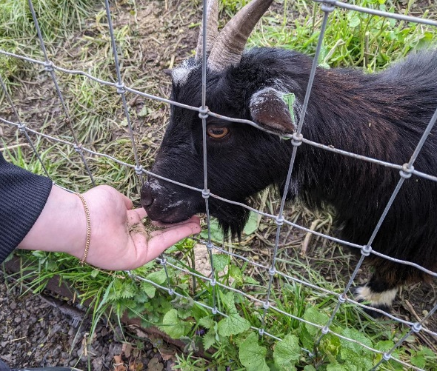
Day Trips
Holiday activities

Slide 15
The Carers Centre
Adult Family Carers Voices Video (10 mins)
Telford and Wrekin All Age Carers - YouTube

Slide 16
The Carers Centre
Family Young Carers Voices Video (10 mins)
Young Carers Voices Full Movie - YouTube

Slide 17
Contact us:
The Carers Centre Teams
01952 240209
www.telfordcarers.org.uk
admin@telfordcarers.org.uk
info@youngcarerstelfordcarers.org.uk

