Slide 1

Introduction to DBS Products and Services
Telford and Wrekin Safeguarding Partnership
Name: Cathy Taylor
Date: 19th November 2021

Slide 2

Todays Agenda
Outlining the role of the Disclosure and Barring Service.
Understanding DBS checks and role eligibility, including levels of check and workforce
How “regulated activity” with children and adults is defined and what this means in practice.
An organisation’s duties and responsibilities in regards to referring to the DBS.
Understand the DBS barring process and the consequences of being placed on one or both barred lists.
How to get support from DBS.
Making Recruitment Safer

Slide 3
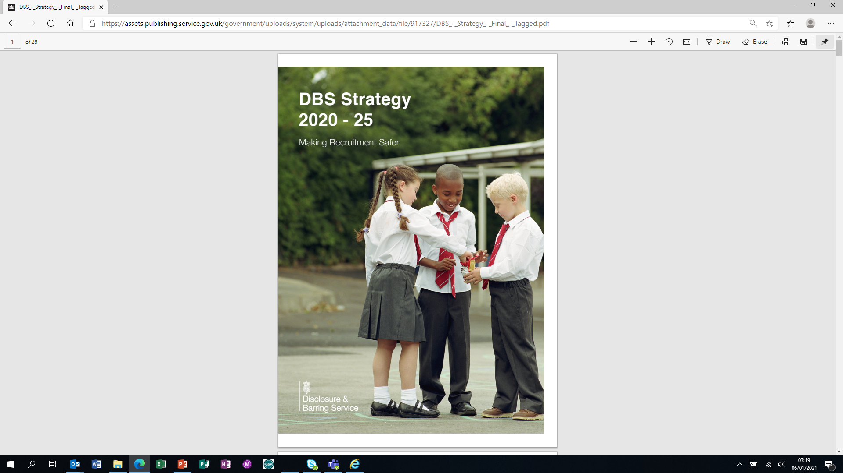
Introduction
Our Purpose: Protecting the public by helping employers make safer recruitment decisions and by Barring individuals who pose a risk to vulnerable groups from working in certain roles.
Our vision: Making Recruitment Safer: By being a visible, trusted and influential organisation, providing an outstanding quality of service to all our customers and partners. Where our people understand the important safeguarding contributions they make and feel proud to work here.
Making Recruitment Safer

Slide 4
The Role of DBS
DBS is responsible for the delivery of disclosure and barring functions on behalf of Government.
        We operate disclosure functions for England, Wales and the Islands under Part 5 of the Police Act 1997 supported by the following:
Rehabilitation of Offenders (Exceptions Order) Act 1975
Safeguarding Vulnerable Groups Act 2006
Protection of Freedoms Act 2012
  We also operate barring functions for England, Wales and Northern Ireland under the following :
  Safeguarding Vulnerable Groups Act 2006
  Safeguarding Vulnerable Groups (Northern Ireland) Order 2007
  Protection of Freedoms Act 2012
Making Recruitment Safer

Slide 5
DBS and You
81.9k
Individuals barred from working with children and/or adults
1.9m
Update Service Subscribers
3.5m
Standard and Enhanced Disclosures
2.2m
Basic Disclosures
Making Recruitment Safer

Slide 6
The Different Levels of DBS Checks
Basic
£23
Standard
£23
Enhanced
£40
Enhanced with Barred List Checks
£40
Unspent convictions and conditional cautions
Spent & unspent convictions, and cautions
(subject to filtering)
Spent & unspent convictions, and cautions
(subject to filtering)
Spent & unspent convictions, and cautions
(subject to filtering)
Relevant Police Intelligence
Relevant Police Intelligence
Children’s and/or adults’ barred list (optional)
Making Recruitment Safer

Slide 7
DBS Filtering Rules
Convictions
All convictions are considered individually
A conviction will be filtered from a criminal record certificate only if:
11 years have elapsed since the date of conviction (5½ years if under 18 when convicted);
it is the person’s only conviction;
it did not result in a custodial (or suspended) sentence;
It is not on the DBS list of specified offences that will never be filtered
Cautions, reprimands or final warnings
A caution for adults will be filtered after 6 years have elapsed since the date of the caution – and only if it does not appear DBS list of specified offences that will never be filtered.
Youth cautions are not disclosed on DBS certificates
Childhood reprimands & warnings will not automatically be disclosed
The police still have the power to disclose this information if it is relevant and ought to be disclosed.
Making Recruitment Safer

Slide 8
The Update Service –supporting your safeguarding measures
Organisations and employers can check online, free of charge with the individual’s consent – the certificate must be at a level that you are able to check and for the correct workforce
Those making the check will be
advised:
Benefits:
Re-check when you need to with the individual’s consent
Cheaper than a 3 yearly re-check
Faster results – you will know instantly if there is no change or if you need to get a new certificate
No new information exists
If the original certificate contained ‘no relevant information’
New information exists
There is no record of the certificate in the service
Making Recruitment Safer

Slide 9
Deciding what level of check you are able to request
Understand:
Who your organisation provides services for – children/adults/both?
What the role involves
How often it is performed
When you need to consider if it is supervised work
Where the role is performed
There are some different rules for roles in Wales
DBS online eligibility guidance
https://www.gov.uk/government/collections/dbs-eligibility-guidance
Making Recruitment Safer

Slide 10



DBS workforces
Police Act 1997 (Criminal Records) regulations separate eligibility for enhanced DBS checks into:
Work with children – the child workforce
Work with adults – the adult workforce
Everything else – the other workforce
Making Recruitment Safer
10

Slide 11
What, how often and is it Supervised?
Regulated activity
 | Once | More than 3 days in a 30 day period | Once overnight with opportunity for contact between 2am and 6am
Providing health care | Yes | Yes | Yes
Providing personal care | Yes | Yes | Yes
Teaching, training and instruction - unsupervised | No | Yes | Yes
Caring for or supervising - unsupervised | No | Yes | Yes
Providing advice or guidance on physical, emotional or educational well being | No | Yes | Yes
Driving children under arrangement | No | Yes | No
Moderating a web based service | No | Yes | No
Registering to be a childminder (inc voluntary reg) | Not applicable
Registering to become a foster carer | Not applicable
Day to day managers of staff in regulated activity
Anyone carrying out this activity would be eligible for the Enhanced with Children’s Barred List check
Making Recruitment Safer

Slide 12
Where - specified establishments, the rules
Regulated activity
Where the activity takes place:
Schools*
Nurseries
Children’s Home
Children’s Centres
Childcare Premises
Children's hospital in Wales
Detention centres for children
*including pupil referral units and alternate provision academies in England
Individuals must satisfy all of the following criteria:
Work there more than 3 days in a 30 day period or overnight between 2am and 6am; and
Have the opportunity for contact with children in the establishment; and
Work there for the purpose of the establishment; and
It’s not a temporary or occasional role or a supervised volunteer role
Making Recruitment Safer

Slide 13
Work with children which is not regulated activity
Supervised teaching/instruction/ caring for or supervising children
- Eligible for an enhanced DBS check
Supervised volunteer in a school or other specified establishments
- Eligible for an enhanced DBS check
Living or working in childminding or childcare premises
Eligible for an enhanced DBS check with a children’s barred list check
Registering to be Adoptive parents
- Eligible for an enhanced DBS check with a children’s barred list check
Anyone carrying out regulated activity but not often enough
- Eligible for an enhanced DBS check
Trustee of a children’s charity
- Eligible for an enhanced DBS check
Making Recruitment Safer

Slide 14
What is done for the adult
Regulated activity
If done once the following activities are regulated activity with adults
Providing health care | By or under the supervision of a healthcare professional
Providing personal care | Washing and dressing, eating, drinking and toileting
Social Work | Provided by a social care worker to an adult who is a client or potential client
Assistance with the day-to-day financial running of the adult’s own household | Managing cash, bills or shopping
Assistance with the conduct of an adult’s affairs | Power of attorney, deputies appointed under Mental Health Orders
Conveying an adult | Must be for health, personal or social care due to age, illness or disability
Anyone carrying out this activity would be eligible for the Enhanced with Adult’s Barred List check
Making Recruitment Safer

Slide 15
Work with adults which is not regulated activity – the rules
Step 1
The adult must be 18 or over
and
Receiving a listed health or social care service
or
Receiving a listed activity set out in legislation
Step 2
The employee must do one or more of the activities below
Train, teach, instruct, provide assistance, advice or guidance
Care for, supervise, provide treatment or therapy
Moderate a public interactive electronic communication service
Work in a care home
Drive adults under contract arrangements
Step 3:
Carry out the work often enough:
more than 3 days in any period of 30 days or
Anytime between 2am and 6am
or
Once a week on an ongoing basis
Making Recruitment Safer

Slide 16
Work with adults – what else is included?
Trustees of adult’s charities
Specific positions in England & Wales
  examples would include CQC inspectors in England, local authority social services staff, Directors of social services in Wales but there are more
Managing anyone who carries out work with adults activities
Use DBS online adult workforce guide for more information
https://www.gov.uk/government/collections/dbs-eligibility-guidance
Making Recruitment Safer

Slide 17
Types of Barring referral
Discretionary
Autobar
Disclosure Information
Type of Referral
Employers
Agencies
Keepers of Registers
Supervisory Authorities
Specified convictions & cautions from PNC
Autobars without representation
Autobars with representation
Enhanced Disclosures with a barred list check that include convictions, cautions or police intelligence
Source of referral
Representations
YES, in all cases
YES, but only where allowed – set out in law
YES, in all cases
Request review
Under 18 – one year; 18 – 24 – five years; 25+ - ten years; a material change
Appeal
Appeals may be made to the Upper Tribunal on a point of law or error in facts
Making Recruitment Safer

Slide 18


Who has a legal duty to refer?
A Regulated Activity Provider
  Employers or voluntary organisations who are responsible for the management or control of regulated activity and make arrangements for people to work in regulated activity
A Personnel Suppliers
  An employment business, employment agency or an educational institution that makes arrangements with a person with a view to supplying that person to employers to undertake regulated activity
Making Recruitment Safer

Slide 19
When you must refer?
OFFICIAL SENSITIVE
When two main conditions have been met
One
You withdraw permission to engage in regulated activity
Dismissed
Redeployed
Retired
Redundant
Resigned
Two
You think the person has either:
Engaged in relevant conduct
Satisfied the harm test; or
Received a caution for or been convicted for a relevant offence
Making Recruitment Safer

Slide 20
What is relevant conduct
Conduct which :
endangers a child or adult or is likely to endanger a child or adult
if repeated against or in relation to a child or adult would endanger the child or adult or be likely to endanger the child or adult
involves sexual material relating to children (including possession of such material)
involves sexually explicit images depicting violence against human beings (including possession of such images)
is of a sexual nature involving a child or adult
Making Recruitment Safer

Slide 21


What is Harm?
A person’s conduct endangers a child or adult if they:
  harm a child or adult
  cause a child or adult to be harmed
  put a child or adult at risk of harm
  attempt to harm a child or adult
  incite another to harm a child or adult
Making Recruitment Safer

Slide 22
Examples of Abuse and Harm
Physical abuse
Sexual abuse
Psychological & Emotional abuse
Extremism
Financial abuse
Assault
Hitting
Slapping
Misuse of medication
Improper restraint
Shaking
Throwing
Poisoning
Burning or scalding
Suffocating
Cc
Sexual teasing or innuendo
Indecent images
Rape
Indecent exposure
Sexual harassment
Inappropriate looking or touching
Humiliation
Blaming
Controlling
Cyber abuse Making a vulnerable person feel worthless, unloved or inadequate,
Not giving them opportunities to express their views
Imposing inappropriate expectations
Extremism goes beyond terrorism. Includes people who target the young, vulnerable by seeking to sow division between communities on the basis of race, faith or denomination; justifies discrimination towards women and girls
Unauthorised withdrawal from accounts
Theft
Fraud
Exploitation Pressure in connection with wills or inheritance
Internet scamming
Misappropriation of property, possessions or benefits
Neglect / Omission
Untreated weight loss. Failing to administer reasonable care resulting in pressure sores or uncharacteristic problems with continence. Poor hygiene, soiled cloths not changed, insufficient food or drink. Unmet social or care needs.
Making Recruitment Safer

Slide 23
Typical Barring Decision Making Process
Reviews
After minimum barring period or at any time if statutory conditions met
Appeals
On the grounds of ‘error of fact’ or an ‘error of law’
Relevant offences
(Autobar) without representations
Stage 5
  Barring Decision
Stage 4
  Representations from the referred person
Relevant offences
(Autobar) with representations
Stage 3
  Structured Judgement Process
Case can be closed at any stage
Stage 2
  Information Gathering and Assessment
The Barring Decision Making Process may vary according to the nature of the referral
Stage 1
  Initial case assessment
Relevant offences
Referral Route
Making Recruitment Safer

Slide 24


Impact of being barred from regulated activity across UK jurisdictions
Children’s Barred List - not allowed to engage in regulated activity with children in England, Wales and Northern Ireland.
Adults’ Barred List - not allowed to engage in regulated activity with vulnerable adults in England, Wales and Northern Ireland.
It is a criminal offence to work, seek work or offer to work in regulated activity when barred on the relevant list.
It is a criminal offence for a person to permit an individual they know (or have reason to believe) is barred from regulated activity to engage in regulated activity.
Maximum penalty 5 years imprisonment and or a fine
The bar also applies to regulated work in Scotland
Making Recruitment Safer

Slide 25
What it means to be barred
Age at time of barring decision | Minimum period of inclusion in barred list (s)
Under 18 | 1 Year
18 – 24 | 5 Years
25 and over | 10 Years
  Life bar unless review requested
Making Recruitment Safer

Slide 26
Regional Outreach Advisers
OFFICIAL SENSITIVE
Regions covered so far:
North West
North East
East Midlands
Wales
Northern Ireland
Greater London
Work closely with organisations in their region to develop relationships and raise awareness of DBS as a safeguarding organisation
Listen to needs, discussing any issues or barriers local organisations may have come across
Developing and delivering sessions that may support organisations in safeguarding and safer recruitment
Making Recruitment Safer

Slide 27
Regional Outreach Advisers
OFFICIAL SENSITIVE
Currently recruiting for Outreach Advisers for the following regions:
West Midlands
East
Yorkshire and Humberside
South West
South East
Details of vacancies can be found at Search results - Civil Service Jobs - GOV.UK
Making Recruitment Safer

Slide 28
How to contact us
Please get in touch for bespoke support:
Questions about DBS checks, eligibility and regulated activity
Support with making barring referrals and the “legal duty to refer”
Delivery of training and workshops directly to your team or network
Support your training programmes that require DBS information
Provide us feedback so we can improve our DBS products and services
Regional Outreach : DBSregionaloutreach@dbs.gov.uk
Further information -
Customer Services: 03000 200 190
Email: customerservices@dbs.gov.uk
Barring: contactus.barring@dbs.gov.uk
Website: www.gov.uk/dbs
Facebook: https://www.facebook.com/dbsgovuk/
Twitter: https://twitter.com/DBSGovUK
Making Recruitment Safer

Slide 29
Useful Links
DBS Guidance Leaflets
DBS Check process explained - video
DBS eligibility guidance
Eligibility guidance for enhanced DBS checks
DBS Barring Referral Guidance
DBS Barring Referral Form and Guidance
How to make a Good Quality Barring Referral
.
Making Recruitment Safer

Slide 30
Evaluation and close
Thank you for listening
Any questions?
Disclosure & Barring Post Event Survey (Overview) (surveymonkey.co.uk)
Making Recruitment Safer

