Slide 1
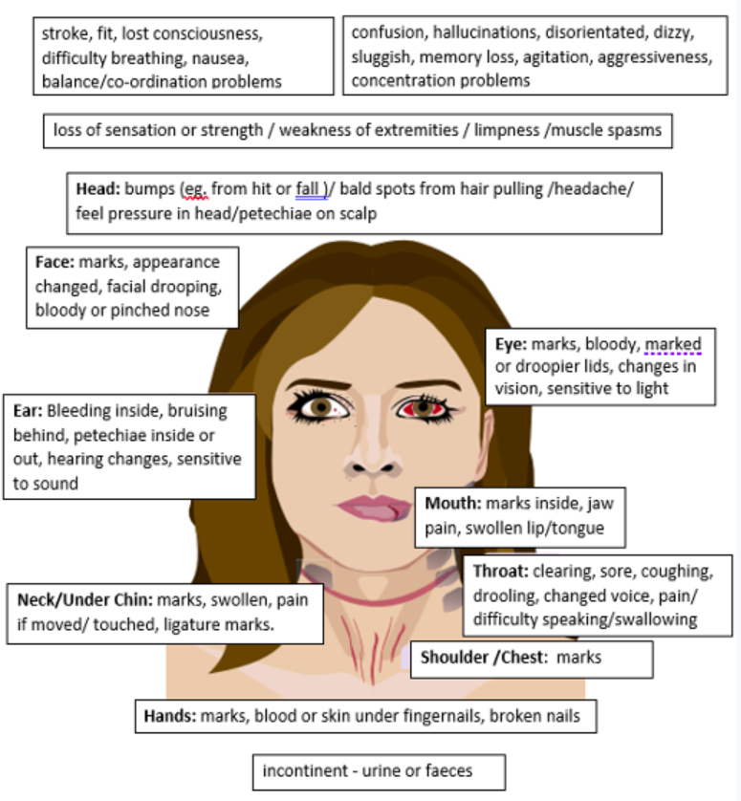
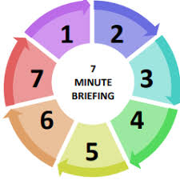
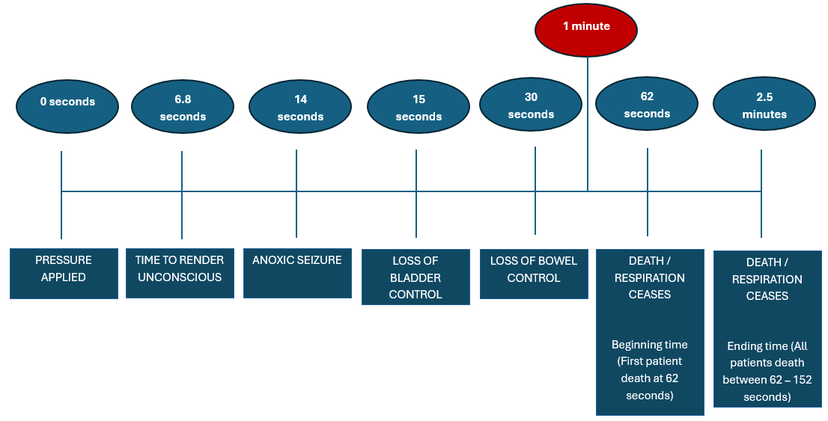
Non-fatal strangulation is a High-risk factor of domestic abuse
ALL NON-FATAL STRANGULATION CASES MUST BE REPORTED TO THE POLICE. IT IS A CRIME!
As well as safeguarding assessments and referral for the patient, consider the safety and welfare of any children under 18 years who are linked to the patient or perpetrator
Non-fatal strangulation
Definitions
Strangulation is defined as asphyxia by closure of the blood vessels and/or air passages of the neck as a result of external pressure on the neck. There are three main categories: hanging, ligature strangulation and manual strangulation.
Non-fatal strangulation (NFS) is where the patient has not died. NFS is not always linked to domestic abuse cases, it can be caused by any person and may not be someone personally connected to the victim.
Statistics – taken from the Institute for Addressing Strangulation
Strangulation and suffocation became standalone offences in England and Wales in 2022, and there were 23,817 reports of strangulation and suffocation made to the police in the first year of the offence being in place.
A review of data from Women’s Aid showed that 1 in 4 women accessing their community based and refuge services reported having experienced strangulation or suffocation.
A ‘key findings’ report from the Home Office, which examined 124 Domestic Homicide Reviews between October 2019 and October 2020, found that in 25% of homicides, the method of killing was strangulation. In this report 80% of the victims were female and 20% male.
Signs & Symptoms
Do not be reassured by lack of physical signs, professionals need to be aware that only 50% of people who are strangled will have any visible injury to the neck or head. Internal injury, including carotid artery dissection and acquired brain injury, can occur without external injuries. Patients may be confused secondary to oxygen deprivation at the time and be unable to provide a clear chronological account of events.

