Slide 1



Telford & Wrekin Council
Cindy Mason-Morris
Armed Forces Covenant Co-ordinator
Ministry of Defence
Smita Mehta
AF Covenant Legislation Policy 1

Slide 2

CONTENT
Introduction.
What is the Covenant?
Armed Forces Community?
The Covenant in Telford & Wrekin.
Successes to date.
Armed Forces Act 2021 & New Covenant Duty.
RCGP Veterans Friendly Accreditation Scheme.
Questions.

Slide 3




PORTSMOUTH
WHITEHALL, LONDON
BRISTOL
DONNINGTON
ANDOVER, HAMPSHIRE
DUSSELDORF, GERMANY
STAFFORD
SUTTON COLDFIELD

Slide 4

What is the Armed Forces Covenant

Slide 5
“The Armed Forces Covenant is a promise by the nation ensuring that those who serve, or who have served, in the Armed Forces, and their families, are treated fairly”.

Slide 6

Armed Forces Covenant
Voluntary Pledge by the Nation.
Principles of the Covenant:
  The Armed Forces community should not face disadvantage compared to other citizens in the provision of public and commercial services.
  Special consideration is appropriate, in some cases, especially for those who have given most such as the injured and the bereaved.
Local Authorities.
Businesses and Charitable Organisations.
Funding.

Slide 7

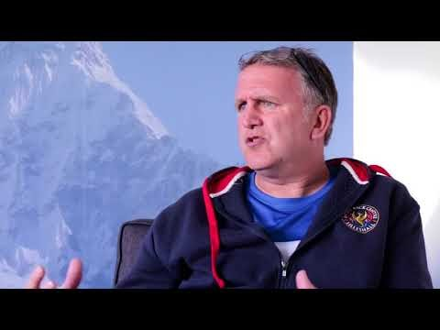
BATTLE BACK CENTRE
LILLESHALL

Slide 8
Armed Forces Community?
Members of the Regular Armed Forces & the Reserves.
Members of British overseas territory forces who are subject to Service law.
Former members of any of Her Majesty’s forces who are ordinarily resident in the UK.
Relevant family members.

Slide 9
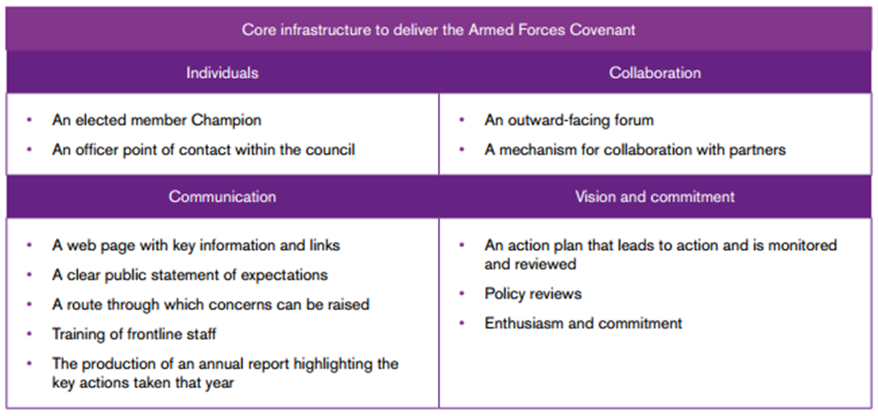
Telford & Wrekin Partnership

Slide 10
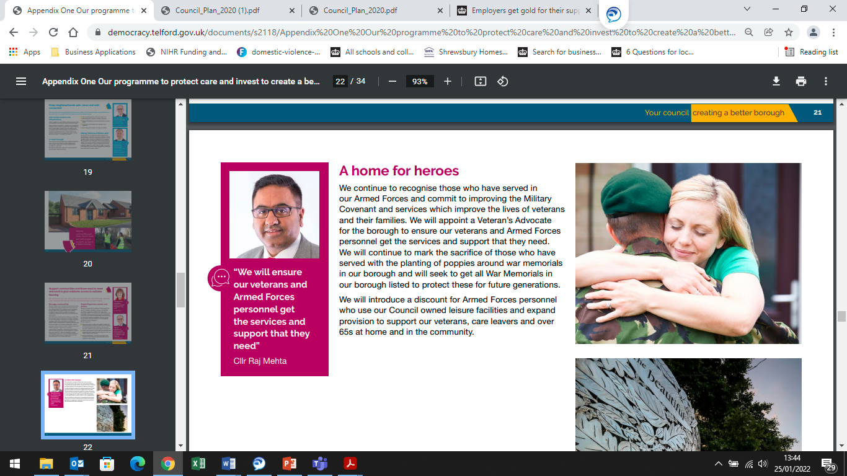

Slide 11
Telford & Wrekin Partnership
Notes:
Looking locally, we have a core infrastructure in place to deliver the Armed Forces Covenant.
Firstly, we have an elect member – Cllr Chris Turley –as the Armed Forces Champion and also, Cllr Paul Watling who is the Cabinet Member with portfolio responsibility for the Covenant.
Then we have – myself – who acts as the officer point of contact within the Council. This can be contact from a range of organisations and government departments such as the Ministry of Defence and the Department of Education, to Service Charities such as the Royal British Legion and SSAFA, non-Service Charities e.g. Age UK and also contact from our Armed Forces communities on a wide range of subjects and issues.
The Covenant is delivered by collaboration primarily through the Telford & Wrekin Strategic Armed Forces Covenant Partnership Board which meets quarterly and is made up of approximately 50+ partners from the private sector, voluntary sector and the public sector including the DWP, West Mercia Police, the NHS and the Shropshire, Fire and Rescue Service.
We communicate through a web page with key information and links and also, an Armed Forces Community Group facebook page. There is Armed Forces Covenant training on Ollie for Front line staff which is currently being updated to include the new legislation. Telford & Wrekin Council have made a clear public statement of expectations in “Our Programme to Protect, Care & Intent to Create a Better Borough Plan 2020-21”. (CLICK)
Regarding, the Route Through Which Concerns Can Be Raised – we recently created an online enquiry/referral form, on the Council’s Armed Forces Covenant webpages, that can be completed by partner organisations or by members of the Armed Forces Community. The completed form goes straight to the Armed forces Community mailbox and is prioritised to ensure effective signposting or that relevant support can be made available.
Finally, we have an action plan in place and policies are reviewed regularly e.g. the annual leave policy was updated to ensure that our Reservists were able to undertake 10 day paid leave each year to attend their fortnightly training camp.
And, of course, everything we do, around the Covenant, is done with enthusiasm and commitment even if it’s just helping the veteran who phoned me up one day to say that his boiler was leaking and he couldn’t get any response from the three plumbers list on the Council’s CheckATrader list!

Slide 12
The Covenant in Telford
Strategic Partnership Group
Operations Group
Business Engagement
Community Engagement
Covenant Signings

Slide 13
Principles of The Armed Forces Covenant
Section 1:
no member of the Armed Forces Community should face disadvantage in the provision of public and commercial services compared to any other citizen;
in some circumstances special treatment may be appropriate especially for the injured or bereaved.

Slide 14

SP Services Covenant Pledges
SP Services (UK) Ltd recognises the value serving personnel, reservists, veterans and military families bring to our business. We will seek to uphold the principles of the Armed Forces Covenant by:
promoting the fact that we are an Armed Forces-friendly organisation;
seeking to support the employment of veterans young and old including those injured or disabled during combat operations;
striving to support the employment of Service spouses and partners where applicable;
endeavouring to offer a degree of flexibility in granting leave for Service spouses and partners before, during and after a partner’s deployment where applicable;
seeking to support our employees who choose to be members of the Reserve forces, including by accommodating their training and deployment where possible;
offering support to local cadet units, either in our local community or in local schools, where possible;
aiming to actively participate in Armed Forces Day and similar events, where possible;
offering a 10% discount to all Armed Forces personnel, both past and present, on any order placed online or in our showroom;
offering free use of our meeting rooms and facilities at Bastion House, Hortonwood, Telford.

Slide 15

DeafNAble Covenant Pledges
DeafnAble recognises the value serving personnel, reservists, veterans and military families bring to our business. We will seek to uphold the principles of the Armed Forces Covenant, by:
Promoting the Armed Forces: promoting the fact that we are an Armed Forces-friendly organisation, to our customers, clients and the wider public.
Veterans: supporting fellow veterans who are sufferers of deafness, including directing to entitlements, and helping to build strategies to manage hearing loss and all the complications that follow hearing loss.
National Events: supporting Armed Forces Day, Reserves Day, the annual National Poppy Appeal and Remembrance activities and support other organisations with signposting/referrals and promoting them to help better their services as well as build up a loyal partnership together.

Slide 16
The Covenant in Telford
Strategic Partnership Group
Business Engagement
Community Engagement
Covenant Signings
Events and Activities
Outreach e.g. Calm Cafes for Veterans
Defence Employer Recognition Scheme

Slide 17














Who we work with?

Slide 18
SUCCESSES TO DATE
Core infrastructure in place.
Joint Armed Forces Needs Assessment.
Employer Recognition Scheme Gold Award.
Growing number of businesses/organisations signed up to the Covenant.
Calm Cafes for Veterans.

Slide 19
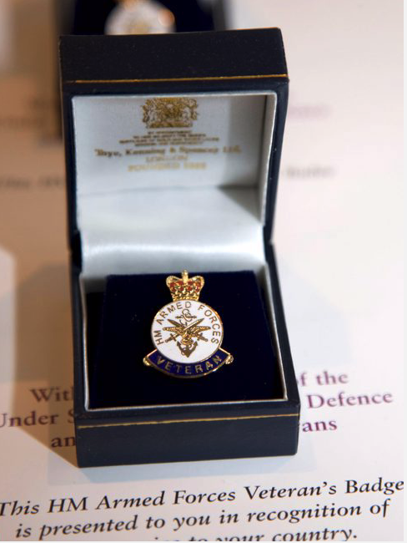
RCGP Veterans Accreditation
Why our programme is important both for GPs and patients?
Supports practices to identify and code their veterans, and to appoint a clinical lead who undertakes training and other activities related to veteran healthcare.
We provide accredited practices with an information pack to help increase their understanding of the health needs of veterans, and the services available to them.
Practices provide evidence that they are supportive of veterans’ healthcare.
Crown Copyright 2021

Slide 20
NHS Mental health support for veterans, service leavers and reservists
Op COURAGE: the NHS Veterans Mental Health and Wellbeing Service
  Everyone at Op COURAGE is either from the armed forces community or is experienced in working with serving personnel, reservists, veterans and their families.
Contacting Op COURAGE
  directly getting in touch yourself, or through a family member or friend
  asking a GP to refer you
  asking a charity to refer you
For more information, visit the NHS website at www.nhs.uk/opcourage

Slide 21
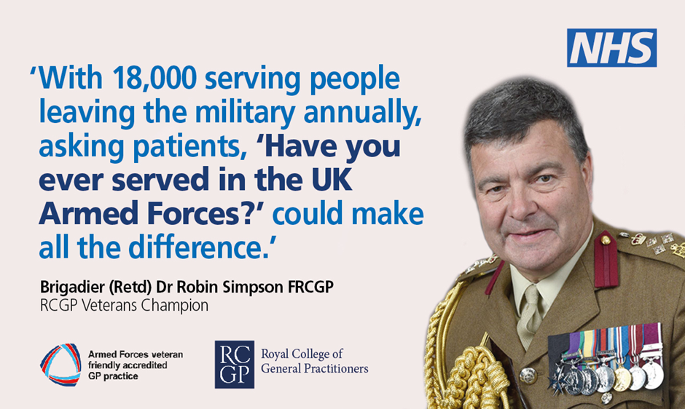
www.rcgp.org.uk/veterans
veterans@rcgp.org.uk

Slide 22
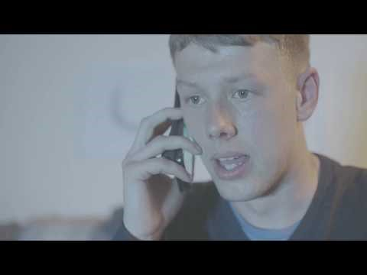
A Young Soldier's Challenges After Leaving the Forces

Slide 23
Any Questions?
cindy.masonmorris@telford.gov.uk

