Slide 1

Safeguarding Adult Review’s
(SAR’s)
Awareness Seminar – June 2022

Slide 2
SAFEGUARDING ADULT REVIEWS
(an overview)
“ ..Experience is making a mistake and learning from it.. ”

Slide 3
AIM OF THIS TRAINING
Hopefully, by the end of this training you will be able to understand the structure that underpins adult safeguarding and the statutory review process.
This training will also explain the role of the Safeguarding Partnership and the boards and panels that work under its umbrella - with the national picture being explored and SARs on a local level being demonstrated.
Overall the aim of this training is to raise awareness of the referral process for potential SARs which, in themselves, promote improvement.

Slide 4
What is safeguarding?
This space has been left intentionally blank

Slide 5
Safeguarding Adult Reviews
The Care Act 2014 s.44 Safeguarding adults reviews
(1)An SAB must arrange for there to be a review of a case involving an adult in its area with needs for care and support (whether or not the local authority has been meeting any of those needs) if—
  (a)there is reasonable cause for concern about how the SAB, members of it or other persons with relevant functions worked together to safeguard the adult, and
  (b)condition 1 or 2 is met.
(2)Condition 1 is met if—
  (a)the adult has died, and
  (b)the SAB knows or suspects that the death resulted from abuse or neglect (whether or not it knew about or suspected the abuse or neglect before the adult died).
(3)Condition 2 is met if—
  (a)the adult is still alive, and
  (b)the SAB knows or suspects that the adult has experienced serious abuse or neglect.
(4)An SAB may arrange for there to be a review of any other case involving an adult in its area with needs for care and support (whether or not the local authority has been meeting any of those needs).
(5)Each member of the SAB must co-operate in and contribute to the carrying out of a review under this section with a view to—
  (a)identifying the lessons to be learnt from the adult’s case, and
  (b)applying those lessons to future cases.

Slide 6
Why have a SAR?
“ ..It’s not about blame, but learning.. ”

Slide 7
How do we learn?
LEARN from practical instances where agencies could have worked together more effectively by -
CONSIDERING whether the serious harm could have been prevented and whether steps could prevent such instances in the future
IDENTIFYING any issues in multi or single agency policies and procedures
ENGAGING with families and agencies to investigate
AGREEING how we learn from the issue and what we expect to change and,
PUBLISHING a summary report, which is made available to the public.

Slide 8
TWSP / SAB / SAR – in focus
Telford and Wrekin Safeguarding Partnership is an entity made up of local partner agencies addressing local safeguarding issues and working towards a safer borough
The Safeguarding Adults Board is a function of the Partnership looking specifically at adults and adult safeguarding
The Safeguarding Adult Review Panel is a group of partner agencies working together to identify, investigate and learn from instances of concern in the borough that may, or may not, meet the Care Act thresholds for a full review

Slide 9

The process?
Referral
  Following the criteria in s.44 anyone can refer in a matter to the Telford and Wrekin Safeguarding Partnership (“TWSP”)
    Where there is reasonable cause for concern about how the SAB, partner members of it or other persons with relevant functions worked together to safeguard an adult and the adult has died or abuse/neglect is known or suspected then a review should take place.
  Link to the TWSP referral form easy available on the website
    For those within Telford and Wrekin Council who have concerns not fitting the SAR criteria please still refer via Family Connect
  “ ..If we don’t know, then we can’t learn.. ”

Slide 10

“.. What if the referral received is deemed to not meet the threshold for a SAR?.. ”
Excellent question –
  The problem with setting a bar is that not everything reaches the bar. Ignoring the instances that are below the bar defeats the idea of learning therefore :
  OPTIONS
  Discretionary SAR
  Multi Agency Case File Review

Slide 11
SAR steps
Once a referral is received the SAR Panel will meet to discuss the referral and ‘scope’ the issues. If the threshold previously mentioned is met the SAB will be informed, a SAR directed and agencies involved will appoint an author for the report, investigate and make recommendations on potential learning.
Practitioners involved may be requested to attend workshops arranged by the SAR report author to understand, aid in the learning process and to aid the author.
The SAR panel will then review and agree the findings and learning for approval by the SAB and, once approved, publish an anonymised copy on-line and …….

Slide 12
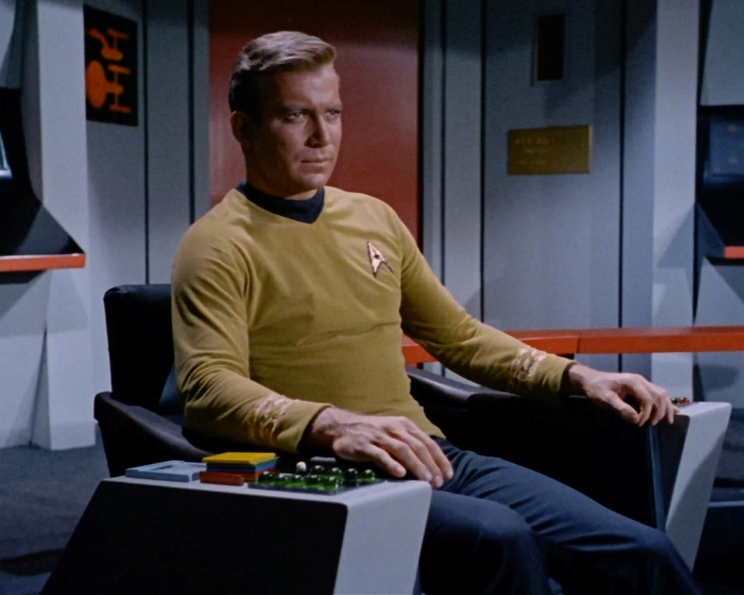
“ ..Make it so.. ”

Slide 13
National SAR Analysis

Slide 14
The Framework
direct practice with the individual
inter-professional and interagency collaboration
organisational features affecting how practitioners and teams worked
SAB leadership, oversight and governance.

Slide 15
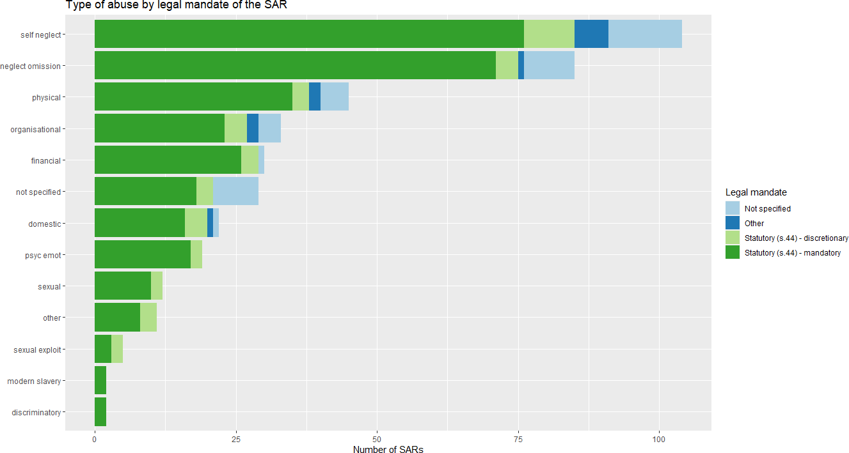

Slide 16
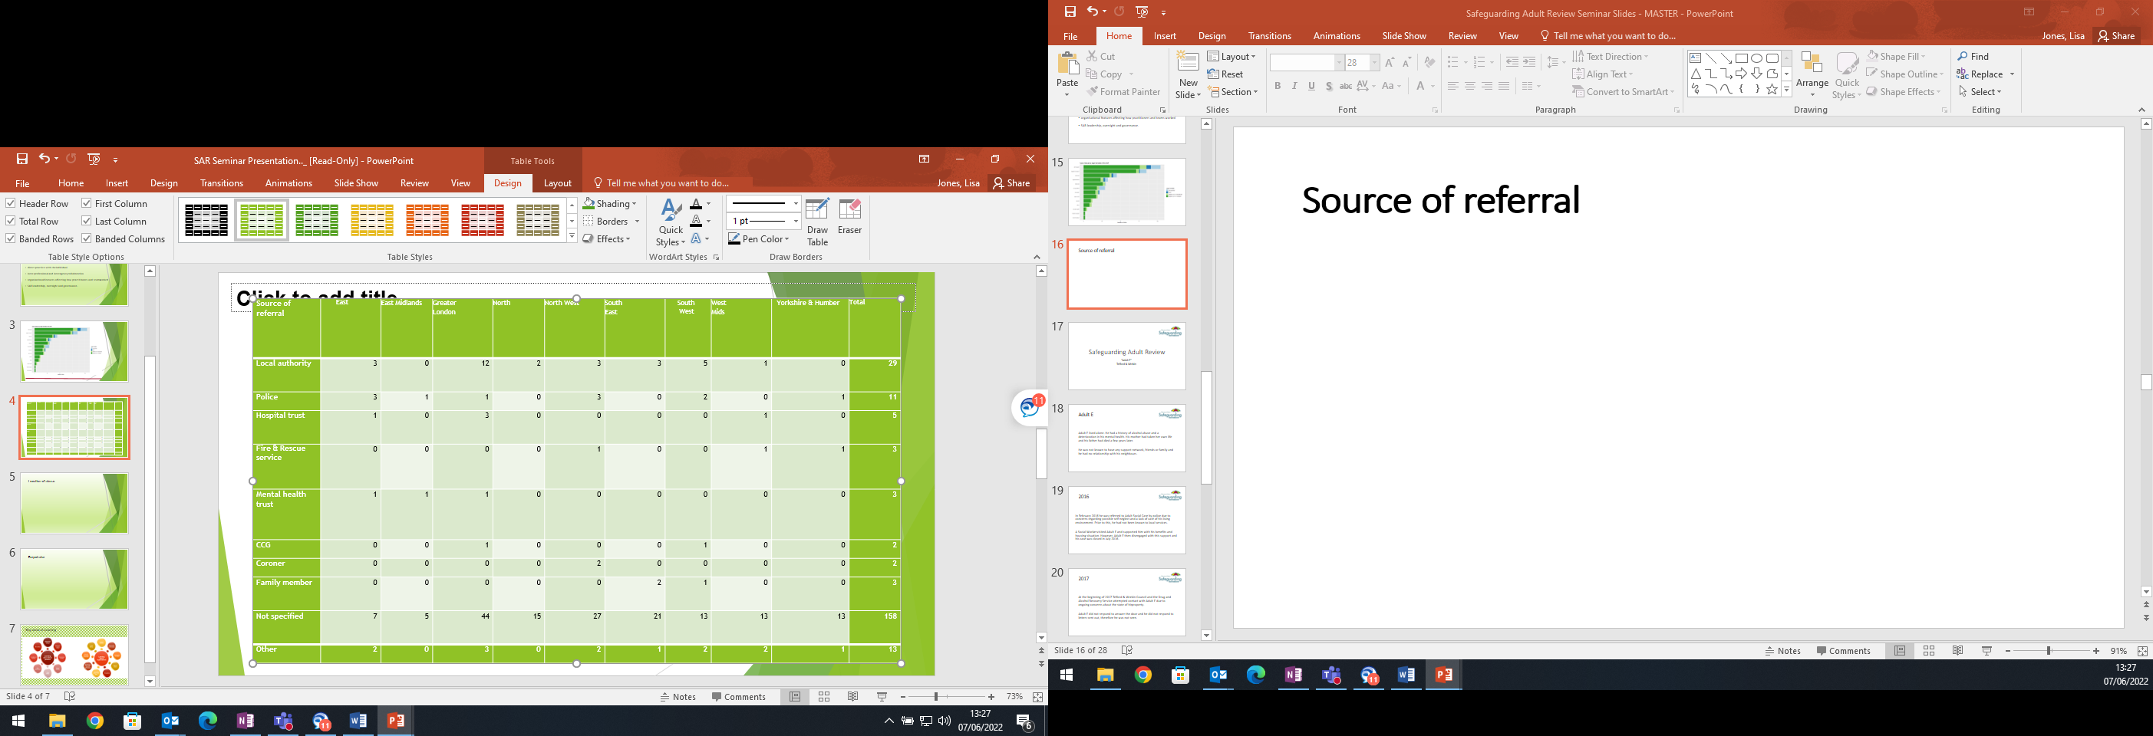
Source of referral

Slide 17
Location of abuse
Location of abuse
Location of abuse | East | East Midlands | Greater London | North East | North West | South East | South West | West Midlands | Yorkshire & Humber | All regions
Care/nursing home | 6 | 0 | 8 | 3 | 9 | 2 | 4 | 5 | 4 | 41
Community (eg on the street) | 2 | 1 | 2 | 0 | 0 | 3 | 1 | 0 | 1 | 10
Community service (eg day centre) | 0 | 0 | 2 | 0 | 0 | 1 | 0 | 0 | 0 | 3
Hospital | 3 | 1 | 5 | 0 | 3 | 7 | 1 | 3 | 4 | 27
Hostel/shelter | 0 | 0 | 3 | 0 | 2 | 2 | 0 | 0 | 1 | 8
Own home – general housing | 8 | 5 | 31 | 7 | 22 | 13 | 13 | 8 | 3 | 110
Own home – sheltered housing | 0 | 0 | 7 | 1 | 0 | 0 | 1 | 0 | 0 | 9
Prison | 0 | 0 | 0 | 0 | 1 | 0 | 0 | 0 | 0 | 1
Someone else’s home | 0 | 1 | 2 | 1 | 1 | 0 | 1 | 1 | 1 | 8
Supported living | 1 | 1 | 4 | 0 | 3 | 4 | 4 | 1 | 0 | 18
Not specified | 0 | 0 | 9 | 4 | 2 | 3 | 1 | 3 | 3 | 25
Other | 1 | 1 | 6 | 1 | 1 | 2 | 1 | 3 | 1 | 17
Total | 21 | 10 | 79 | 17 | 44 | 37 | 27 | 24 | 18 | 277

Slide 18
Perpetrator
Perpetrators by region
Perpetrator of abuse | East | East Midlands | Greater London | North East | North West | South East | South West | West Midlands | Yorkshire & Humber | All regions
Care provider | 5 | 1 | 22 | 3 | 11 | 8 | 6 | 7 | 6 | 69
Other professional | 3 | 0 | 9 | 2 | 1 | 6 | 4 | 1 | 2 | 28
Partner/relative/friend/carer | 4 | 4 | 6 | 2 | 15 | 3 | 3 | 5 | 2 | 44
Self | 9 | 3 | 32 | 8 | 16 | 17 | 14 | 3 | 4 | 106
Social contact/acquaintance | 1 | 2 | 2 | 3 | 1 | 4 | 4 | 3 | 0 | 20
Unknown to individual | 0 | 1 | 1 | 1 | 0 | 2 | 0 | 2 | 0 | 7
Not specified | 0 | 1 | 6 | 2 | 4 | 2 | 1 | 0 | 4 | 20
Other | 0 | 0 | 5 | 0 | 3 | 1 | 2 | 2 | 0 | 13
Total | 22 | 12 | 83 | 21 | 51 | 43 | 34 | 23 | 18 | 307

Slide 19
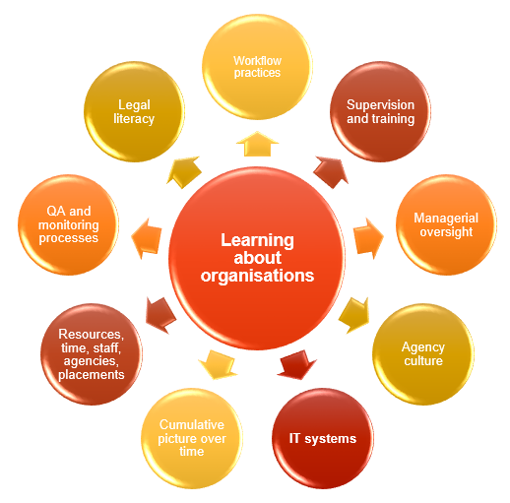
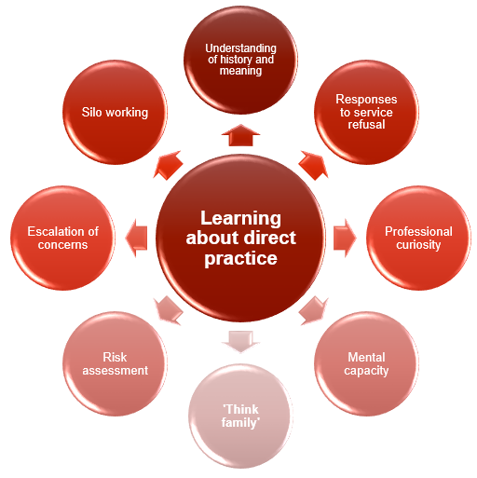
Key areas of Learning

Slide 20
Safeguarding Adult Review
“Adult E”
Telford & Wrekin

Slide 21
Adult E
Adult E lived alone. He had a history of alcohol abuse and a deterioration in his mental health. His mother had taken her own life and his father had died a few years later.
He was not known to have any support network, friends or family and he had no relationship with his neighbours.

Slide 22
2016
In February 2016 he was referred to Adult Social Care by police due to concerns regarding possible self neglect and a lack of care of his living environment. Prior to this, he had not been known to local services.
A Social Worker visited Adult E and supported him with his benefits and housing situation. However, Adult E then disengaged with this support and his case was closed in July 2016.

Slide 23
2017
At the beginning of 2017 Telford & Wrekin Council and the Drug and Alcohol Recovery Service attempted contact with Adult E due to ongoing concerns about the state of his property.
Adult E did not respond to answer the door and he did not respond to letters sent out, therefore he was not seen.

Slide 24
19 April 2017
On 19 April 2017 police were called by a neighbour as two young people had entered Adult E’s garden to retrieve their ball and had discovered a dead body inside the house.
The Police described the house as being ‘in a state of disrepair’ and that the body appeared to have ‘been in situ for a prolonged period of time’.
Adult E was 43 years old at the time of his death. He was last seen alive on the 22nd September 2016 when he attended the Telford Department for Work and Pensions Office (DWP).

Slide 25
Could anything more have been done to support Adult E?

Slide 26
Conclusions
The Coroner’s inquest found it reasonable to assume that Adult E’s death was not directly predictable, or therefore preventable. However, there were missed opportunities to engage with him, which could have promoted his quality of life and wellbeing.
The agencies who tried to engage with Adult E did not make use of the multi-agency procedures and forums that could have facilitated a more holistic approach to supporting him and there was a lack of multi-agency forums for sharing concerns about cases of possible self-neglect.
It also found, however, that it is highly likely that based on evidence, he would not have engaged with these services.

Slide 27
Recommendations
That partner agencies review their “did not attend” policy and ensure it is fit for purpose and takes into account the needs of their service users.
That Adult Social Care reviews its procedure in closing cases to ensure it is proportionate.

Slide 28
Recommendations
To ensure that partner agencies and their staff can effectively implement the Mental Capacity Act 2005.
To ensure that partner agencies and their staff are able to identify signs of self neglect and are able to raise appropriate referrals to seek support.
That partner agencies encourage staff to develop and exercise ‘professional curiosity’ when screening referrals and undertaking assessments.

Slide 29
Recommendations
That the Board undertake work with other local community partnerships to develop a multi-agency strategy and forum to manage cases of self-neglect before they deteriorate to the point of becoming an adult safeguarding concern.
That the Board review and revise its monitoring processes to ensure adult safeguarding and Making Safeguarding Personal are embedded in the policies, procedures and practices of partner agencies and the services they commission.

Slide 30
Thank you!

Slide 31
Useful links
Telford and Wrekin safeguarding Partnership
Telford and Wrekin Safeguarding Partnership (telfordsafeguardingpartnership.org.uk)
Regional Safeguarding SAR Policy
West Midlands Regional Safeguarding Information Hub (safeguardingwarwickshire.co.uk)
TWSP - SAR referral form
Safeguarding Adults Review (SAR) referral form - Telford and Wrekin Safeguarding Partnership (telfordsafeguardingpartnership.org.uk)

