Slide 1

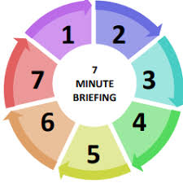
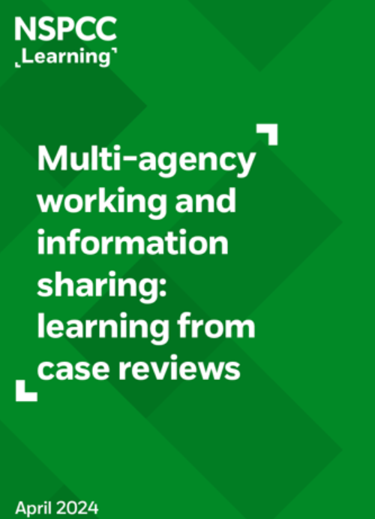
Multi-agency working and information sharing
Background
Multi-agency working and information sharing are key to effective safeguarding and child protection (DfE, 2023). Information sharing is essential for identifying patterns of behaviour, or circumstances in a child’s life that may be evidence that they are at risk of harm or being harmed and need some form of support or protection. As stipulated in DfE (2024), data protection legislation (Data Protection Act, 2018) and the UK General Data Protection Regulation (GDPR) does not prevent the sharing of information for the purpose of safeguarding children, when it is necessary, proportionate and justified to do so.
Time to reflect…
In your practice, who are you likely to share information with?
How confident are you to share information in relation to a child or young person?
How confident are you to have a conversation with the family to advise them you are sharing information (if deemed safe to do so)?
How could you enhance information sharing in your practice?
Do your records clearly capture decisions around information sharing?
Are there barriers in your practice to share information? If so, how do you overcome these?
How do you ensure your have “closed the loop” and obtain feedback when required?
Do you know who to contact within your organisation if you were unsure whether to share information?
Are you aware of the benefits of sharing information to safeguard children and young people?
7 Golden Rules (DfE, 2024)
All children have a right to be protected from abuse and neglect. Protecting a child from such harm takes priority over protecting their privacy, or the privacy rights of the person(s) failing to protect them.
When you have a safeguarding concern, wherever it is practicable and safe to do so, engage with the child2and/or their carer(s), and explain who you intend to share information with, what information you will be sharing and why.
You do not need consent to share personal information about a child and/or members of their family if a child is at risk or there is a perceived risk of harm.
Seek advice promptly whenever you are uncertain or do not fully understand how the legal framework supports information sharing in a particular case.
When sharing information, ensure you and the person or agency/organisation that receives the information take steps to protect the identities of any individuals (e.g., the child, a carer, a neighbour, or a colleague) who might suffer harm if their details became known to an abuser or one of their associates.
Only share relevant and accurate information with individuals or agencies/organisations that have a role in safeguarding the child and/or providing their family with support, and only share the information they need to support the provision of their services.
Record the reasons for your information sharing decision, irrespective of whether or not you decide to share information.
Key Documents
Department for Education (DfE) (2023) Improving multi-agency information sharing (PDF). [London]: Department for Education
DfE non statutory information sharing advice for practitioners providing safeguarding services for children, young people,parents and carers
Department for Education (DfE) (2024) Information Sharing: Advice for practitioners providing safeguarding services for children, young people, parents and carers. [London]: Department for Education
Child Safeguarding Practice Review Panel (2024) Annual report 2022/23: patterns in practice, key messages and 2023/24 work programme (PDF). [London]: Child Safeguarding Practice Review Panel

