Slide 1
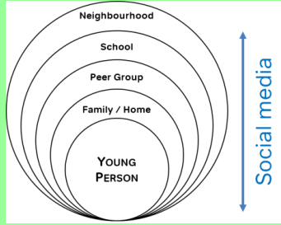
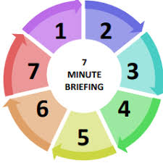
Contextual Safeguarding
1. What is it?
Contextual safeguarding seeks to identify and respond to harm and abuse posed to young people outside of their home, either from adults or other young people.
2. Why does it matter?
Traditional approaches to protecting children and young people from harm have focussed on the risk of violence and abuse from inside the home, and do not always address the time that children and young people spend outside the home. As children move from childhood into adolescence they spend increasing amounts of time socialising independently of their families. Contextual safeguarding recognises that the different relationships that young people form in their neighbourhoods, schools and online can feature violence and abuse. Parents and carers have little influence over these contexts and young people’s experiences of extra-familial abuse can undermine parent-child relationships.
3. Expanding the capacity to safeguard:
website.
6. Push Factors – some reasons that could lead to a young person becoming distant from the people who would usually protect them:
• Living with domestic abuse
• Being thrown out of home
• Family behaviours and beliefs
• Being in a residential or foster placement where they are unhappy
• Alcohol or substance misuse within the home
• Parents with mental health problems
• Having problems at, or not being in school, training or employment
• Being bullied or threatened
• Having siblings with difficulties
• Being in trouble
• Bereavement or significant loss
4. An approach, not a model:
We need to recognise that children and young people are vulnerable to abuse beyond their front doors and via the internet/social media
Target the context in which the abuse occurs, from assessment through to intervention.
Frame work to address extra-familial risk through the lens of child welfare and not crime reduction or community safety
Utilise the partnerships between agencies that reach into extra-familial contexts (transport providers, schools, retailers, resident associations, parks & recreational services etc.)
Measure success with reference to the nature of the context in which the harm has been occurring, rather than focussing on any behaviour changes displayed by young people who were at risk of these contexts
website.
5. Pull Factors - The grooming techniques used to gain the young person’s attention, admiration, and affection often that often tap into their insecurities or desire for acceptance and status:
• Receiving alcohol, drugs, money, or gifts
• Getting a buzz and the excitement of doing something risky or forbidden
• Feeling accepted
• Being offered somewhere to stay where there are no rules
• Being given lifts, taken to new places and having adventures with a casual acquaintance
• Being part of an alternative scene
• Meeting somebody who thinks they are special on the internet/social media
.

