Slide 1
“If you loved me, you’d take the tablets”
- Domestic Homicide Reviews and “Suspected Victim Suicides”
Adult Safeguarding Week Lunch and Learn session 20.11.23
Paul Cooper

Slide 2

I’m a mother, daughter, sister and friend but I’m also the wife of a cruel, monstrous man.
I fought for my life, fought with all that I had,
But I was coerced and controlled and abused so bad.
I was left feeling worthless and scared and sad,
The abuse left me thinking that I was going mad.
Should we question capacity, could that give us a lead?
Please don’t insult me. Question abuse, that’s what I need.
You see, if you ask the right questions and understand who I was,
I’m no longer a body, crime number or report, I die as a victim and that’s who I was.
By Laura, for her twin sister Lyndsay

Slide 3
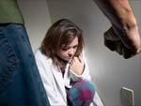
State of knowledge and understanding about DHR, Domestic Abuse and Suicide
Do all agencies understand the DHR criteria
Do all staff understand the risk of suicide in relation to Domestic Abuse
What does the research tell us

Slide 4
Quick recap on DHRs and suicide*
A “domestic homicide review” means a review of the circumstances in
which the death of a person aged 16 or over has, or appears to have, resulted from
violence, abuse or neglect by—
(a) a person to whom he was related or with whom he was or had been in an
intimate personal relationship, or
(b) a member of the same household as himself,
held with a view to identifying the lessons to be learnt from the death.
“Where a victim took their own life (suicide) and the circumstances give rise to concern, for example it emerges that there was coercive controlling behaviour in the relationship, a review should be undertaken, even if a suspect is not charged with an offence or they are tried and acquitted. Reviews are not about who is culpable.”
* QUOTES FROM Multi-agency Statutory Guidance for the Conduct of Domestic Homicide Reviews. HO 2016

Slide 5
Suicide in the DA Statutory Guidance
“The psychological impact of domestic abuse can be so severe that it leads to suicide ideation and attempt.” The severity/duration of abuse, and mental health needs of the victim, may be specific risk factors.
11% of male and 7% of female victims of partner abuse attempted suicide in the previous year[‘18]. 39 suicides linked to DA in 2021. REFUGE state 24% victims felt suicidal; 18% made plans & 3% made attempts
Long term trauma for those with Physical and mental health needs & substance misuse not recognised – need for trauma informed approach

Slide 6

A Focus on Domestic Homicides and Suspected Victim Suicides
Key Research From the Home Office + National Police Chief Council + College of Policing + Vulnerability Knowledge and Practice Programme (VKPP).
The second volume of this research looking at Year 2 (2021 to 2022) was published in Dec. ‘22.
https://www.vkpp.org.uk/vkpp-work/domestic-homicide-project/
https://assets.publishing.service.gov.uk/government/uploads/system/uploads/attachment_data/file/1013128/Domestic_homicides_and_suspected_victim_suicides_during_the_Covid-19_Pandemic_2020-2021.pdf
How can this inform Practice?

Slide 7
Key Findings from 2 year review 2020 -2022
470 Deaths
202 intimate partner homicides
103 adult family member homicides
114 suicides following domestic abuse
97 women and 17 men
No discernible Covid Impact on Homicide rates

Slide 8

Key Data
Methods of all deaths: Knife 28% + Strangulation/Hanging 21% + Poison 10% + other 10% + kick/punch 6% + blunt force 6% + shooting 2% + not know 11%
Locations of deaths: 90% Urban + 10% rural + 66% Home + 9% outdoors + 9% died in hospital of injuries sustained elsewhere + 6% n/k
Gender of suspects: 83% male + 17% female
Gender of victim: 70% female + 30% male

Slide 9

Key Data: gender and ethnicity
Intimate partner homicide victims: 83% female + 17% male
Family member homicide victims: 47% female + 53% male
Suspected victim suicides: 85% women + 15% men
ETHNICITY OF ALL VICTIMS
White 76% + Black 8% + Asian 8%, MIXED 3 % + other 3% + n/k 3%

Slide 10
Critical Risk factors for suspected suicide
(1) Perpetrator already known to Police for DA.
(2) Coercive and controlling behaviours are used
(3) Perpetrator has problems with alcohol
(4) Non-fatal strangulation has been used
(5) Perpetrator misuses drugs

Slide 11
Critical Risk factors for suspected suicide
(6) Perpetrator has mental health problems
(7) Relationship ending increases risk
(8) Perpetrator has experienced depression/anxiety
(9) Perpetrator has previously been suicidal
(10) Perpetrator has also experienced DA.

Slide 12
Non- Fatal Strangulation
Now recognised as a crime in its own right DA 2021 – S70
Creates overwhelming levels of fear and control
Indicator of heightened risk
44% of victims report having been strangled.
In sexual violence, 1 in 11 adults reporting rape describe strangulation as part of the attack.
This rose to 1 in 5 when the alleged rapist was a partner or ex-partner.

Slide 13
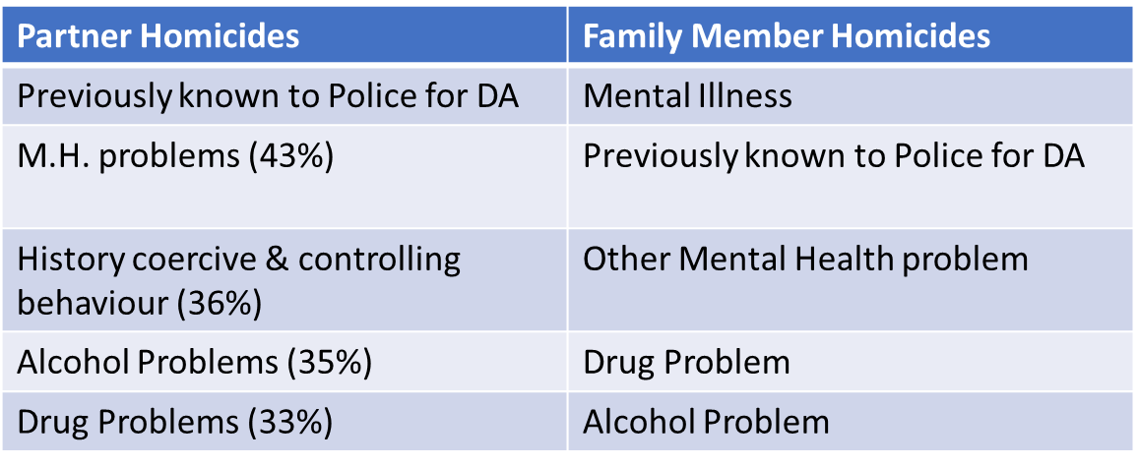
Top 5 risk factors of “perpetrators” in homicides

Slide 14
Signs of Domestic Abuse https://www.gov.uk/government/publications/domestic-abuse-recognise-the-signs
EMOTIONAL | Belittling, blaming, isolating, demanding, accusing, controlling clothes worn, controlling money, controlling behaviour, controlling thoughts, denials - gaslighting
THREATS | Threats to kill, threats to hurt, destroy things, standing over, threats to kill/hurt loved ones, following, monitoring phone
PHYSICAL | Slap, hit, punch, shove, bite kick, burn, choke [non-fatal strangulation]
SEXUAL | Rape, Unwanted touching, pressurising to have sex, sex causing hurt or pain

Slide 15
Local Information
Telford and Wrekin – Domestic Abuse Information
https://www.telford.gov.uk/info/20291/domestic_abuse
Shropshire – Domestic Abuse Information
https://www.shropshire.gov.uk/crime-and-community-safety/domestic-abuse/

Slide 16

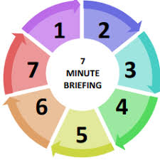
Domestic Homicide Reviews (DHRs) and Suspected Victim Suicides
1.DHRs – why they are important
When a person aged 16+ dies owing to violence, abuse or neglect by a partner, ex-partner or family/household member the Police make a referral for consideration of a DHR. This allows agencies to work together to learn lessons and make plans to improve support in the future. Please see the latest research. https://www.vkpp.org.uk/assets/Files/Domestic-Homicide-Project-Year-2-Report-December-2022.pdf
2.Domestic Abuse and Suicide
Research has shown that between ‘20-’22 114 people died of suspected suicide in the backdrop of domestic abuse. That is 5 people a month. 85% of those who died were women and 15% men. DHR guidance states that when someone has died of suspected suicide in these circumstances then a DHR referral should also be made
3. Risk Factors associated with suicide and Domestic Abuse [DA]
The research has looked at these deaths and identified the risks most associated with suicide when experiencing domestic abuse. These are
(1) Perpetrator already known to Police for DA.
(2) Coercive and controlling behaviours are used
(3) Perpetrator has problems with alcohol
(4) Non-fatal strangulation has been used
(5) Perpetrator misuses drugs
(6) Perpetrator has mental health problems
(7) Relationship ending increases risk
(8) Perpetrator has experienced depression/anxiety
(9) Perpetrator has previously been suicidal
(10) Perpetrator has also experienced DA.
https://www.vkpp.org.uk/vkpp-work/domestic-homicide-project/
7. Other Risks
This briefing focuses on the risks associated with victim suicide in the presence of DA, but it is important to remember during the same period there were 202 homicides caused by (ex)partners and 103 adults died as a result of homicides by family members. Family homicides victims are 47% female and 53% male whereas partner homicide victims are 70% female. It is important to apply this information when working with those groups.
4. Coercive and Controlling behaviour
Is a way of harming, punishing or frightening someone to make them give in and be dominated. It can be done through assaults or more subtle methods such as threats, humiliation or intimidation which is less recognisable. It is an offence under S76 of Serious Crime Act. It includes checking phone/ spending/bank account; controlling access to friends/family; preventing access to see GP or professionals; threatening to expose them or harm them or family/ children or themselves; denying access to interpreter. It can have a devastating impact and people sometimes only realise the impact retrospectively. A survivor explained to us she was told “if you love me you’d take the tablets” in order to kill herself.
5. Help and Support
When aware that someone is experiencing DA consider all of the risk factors, have a conversation with the person in a safe space and consider the various services that are available and when you might need to refer to MARAC. Use the dedicated Domestic Abuse Pathway which explains how to respond to domestic abuse, where to get help and how to refer to MARAC in Shropshire and Telford https://www.shropshiresafeguardingcommunitypartnership.co.uk/media/oa2n0ein/sscp-domestic-abuse-pathway-a3-sep22-v4-pp-1.pdf
https://www.telford.gov.uk/info/20291/domestic_abuse
website.
6. Things to think about
When experiencing DA asking for help can be incredibly hard, not speaking up may be a logical way to prevent harm to themselves or others; so patience and understanding is a minimal requirement. Be professionally curious, be persistent but person centred. Use flags on your organisations system to ensure risks are understood and explain what support is available. Always consider the risk of suicide as well as further violence
.

