Slide 1
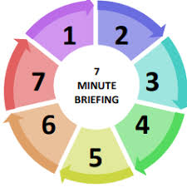
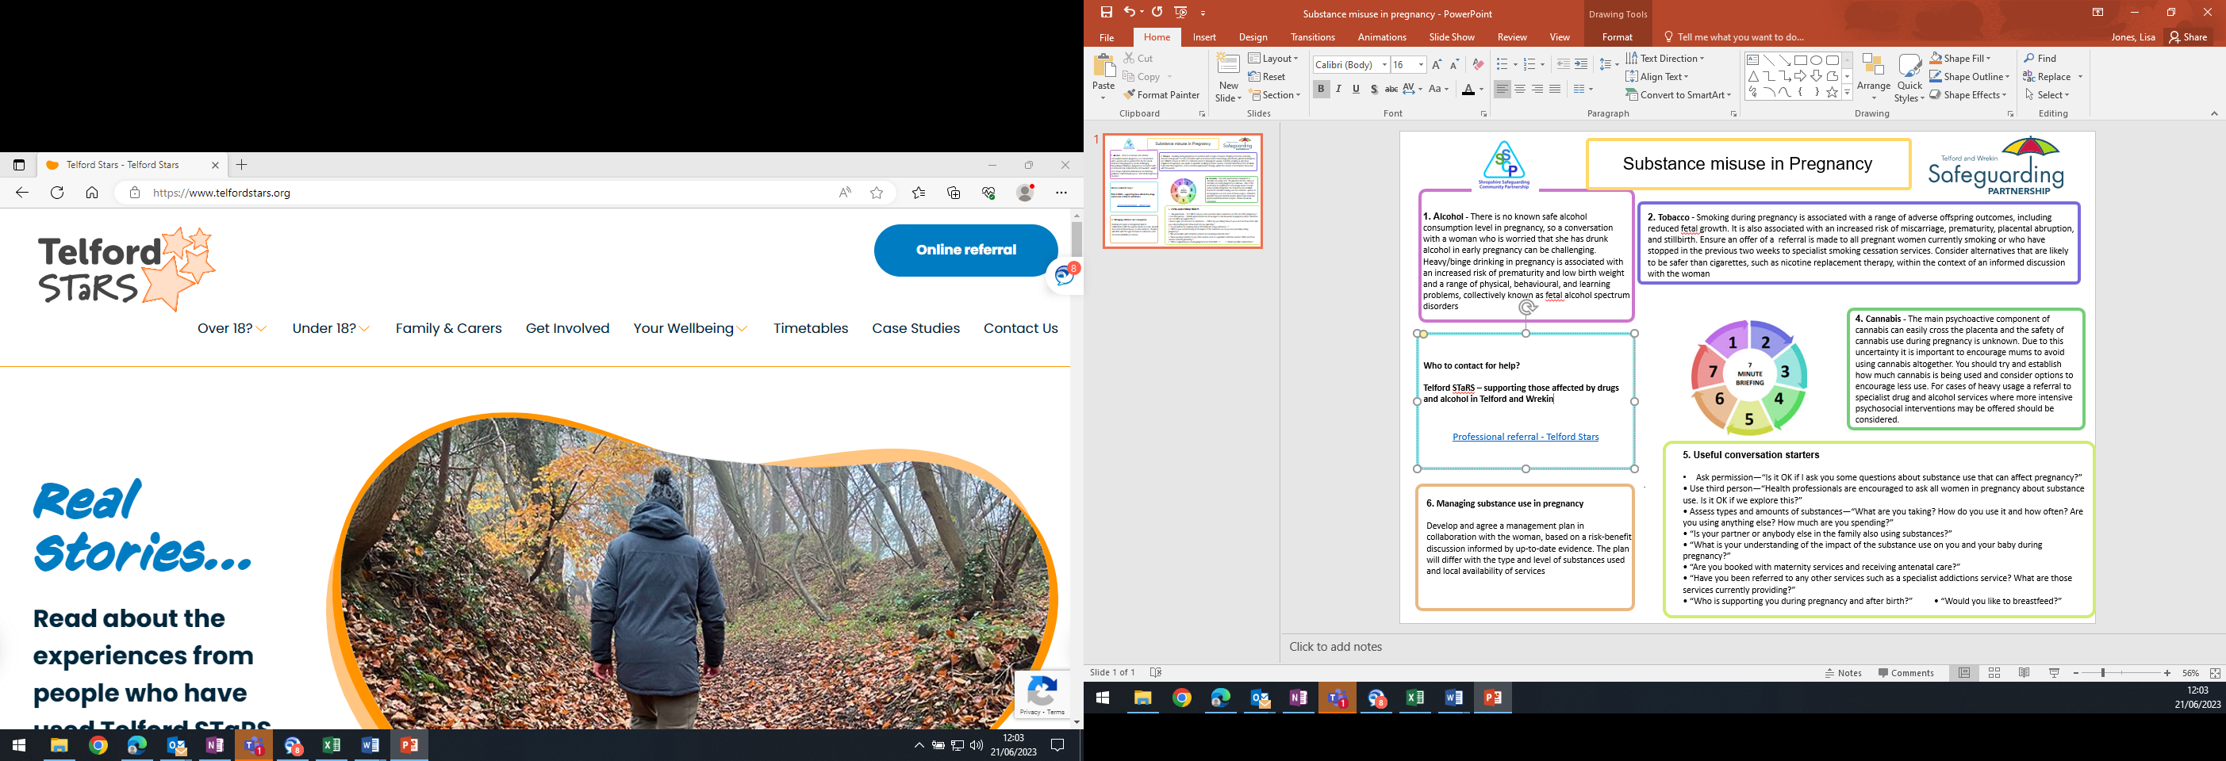
Substance use in Pregnancy
1. Alcohol - There is no known safe alcohol consumption level in pregnancy, so a conversation with a woman who is worried that she has drunk alcohol in early pregnancy can be challenging. Heavy/binge drinking in pregnancy is associated with an increased risk of prematurity and low birth weight and a range of physical, behavioural, and learning problems, collectively known as fetal alcohol spectrum disorders
2. Tobacco - Smoking during pregnancy is associated with a range of adverse outcomes for unborn children, including reduced fetal growth. It is also associated with an increased risk of miscarriage, prematurity, placental abruption, and sadly stillbirth. It is important to ensure an offer of a referral is made to all mums currently smoking or who have stopped in the previous couple of weeks to specialist smoking cessation services. Also, consider alternatives that are likely to be safer than cigarettes, such as nicotine replacement therapy, in conversations with mum so that she can make an informed decision.
3. Cannabis - The main psychoactive component of cannabis can easily cross the placenta and the safety of cannabis use during pregnancy is unknown. Due to this uncertainty it is important to encourage mums to avoid using cannabis altogether. You should try and establish how much cannabis is being used and consider options to encourage less use. For cases of heavy usage a referral to specialist drug and alcohol services where more intensive psychosocial interventions may be offered should be considered.
6. Who to contact for help?
Telford STaRS – supporting those affected by drugs and alcohol in Telford and Wrekin
Professional referral - Telford Stars
website.
4. Useful conversation starters
Ask permission—“Is it OK if I ask you some questions about substance use that can affect pregnancy?”
• Use third person—“Health professionals are encouraged to ask all women in pregnancy about substance use. Is it OK if we explore this?”
• Assess types and amounts of substances—“What are you taking? How do you use it and how often? Are you using anything else? How much are you spending?”
• “Is your partner or anybody else in the family also using substances?”
• “What is your understanding of the impact of the substance use on you and your baby during pregnancy?”
• “Are you booked with maternity services and receiving antenatal care?”
• “Have you been referred to any other services such as a specialist addictions service? What are those services currently providing?”
• “Who is supporting you during pregnancy and after birth?” • “Would you like to breastfeed?”
.
5. Managing substance use in pregnancy
It is important to develop and agree a management plan in collaboration with mum. It is useful to base this on a risk-benefit discussion alongside any relevant evidence. The plan should be different depending on the type and frequency of the substances being used and contain information on support services within Telford and Wrekin.

