Slide 1
Peer-on-Peer Abuse
19th January 2022

Slide 2
Aims of the session
Raise awareness of Peer-on-Peer Abuse.
Teach you what Peer-on-Peer abuse is.
Teach you what to do if you feel like you are being abused, or if someone else is being abused.
To ensure you know the adults you can speak to if you are worried.

Slide 3
What types of behaviour can upset you?
It may be behaviour that hurts you physically
It may be verbal behaviour that hurts you mentally
It may be behaviour that makes you feel unsafe ~ the way some looks at you or whispers things about you.
Discuss this with your partner for 5 minutes.
Be prepared to share something your partner said.

Slide 4
What do you understand by peer on peer abuse?
Take 5 minutes to write your ideas on post-its on your table.
1
Choose one person to be the scribe
2
Be prepared to share your ideas
3

Slide 5

What is peer-on-peer bullying and abuse?
A peer is someone who might be your friend, a child at school with you, or another child you may know.
Abuse is something which usually physically and emotionally hurts another person by using behaviour that is meant to scare, hurt or upset that person.
Sometimes, it can be hard to know when abuse is happening, because not all abuse will hurt, scare or upset you, you might not know it is happening. It’s really important you know when you are being abused so we can make sure it stops.
There are lots of different types of abuse. It is important you know these types of abuse are, so you know what to do if you see them.

Slide 6

What could peer on peer abuse look like?
Bullying (including cyberbullying, prejudice-based and discriminatory bullying).
Physical abuse such as hitting, kicking, shaking, biting, hair pulling or otherwise causing physical harm (this may include an online element, which facilitates threatens and/pr encourages physical abuse).
Abuse in intimate relationships between peers.
Sexual violence and sexual harassment.
Causing someone to engage in sexual activity without consent.
Upskirting, which typically involves taking a picture under a person’s clothing without their permission, to obtain sexual gratification or cause the victim humiliation, distress or alarm.
Consensual and non-consensual sharing of nude and semi-nude images and/or videos (also known as sexting or youth produced sexual imagery).
Initiation/hazing type violence and rituals, which could include activities involving harassment, abuse or humiliation used as a way of initiating a person into a group, and may also include an online element.

Slide 7


What is sexting?
This is sending inappropriate pictures, videos or messages – they can sometimes be called ‘nude pics’, ‘rude pics’ or ‘nude selfies’, but can also be rude messages. Pressuring someone into sending these kind of pictures, videos and messages is abuse.
Even if you are not the person who is sending them, it is illegal to have these kind of pictures or videos of a person if they are under 18 years old.

Slide 8

What is sexual harassment?
Sometimes, people can act sexually towards others, and it might make them feel uncomfortable.
This can happen online on social media, through messages and face-to-face. It might make someone feel scared, embarrassed, uncomfortable, or upset.

Slide 9
It could be:
Someone making sexual comments, like telling sexual stories, saying rude things or saying sexual things about someone’s appearance or clothes.
Calling someone sexual names.
Sexual jokes or teasing
Being physical, like touching which makes you feel uncomfortable, messing with your clothes, or showing pictures or drawings which are of a sexual nature.
Being sexual online, like sharing sexual pictures and videos, or posting sexual comments on social media.
It might also be sexual threats or pushing you to do something sexually that you don’t want to or aren’t ready for.

Slide 10
Relationships
Any relationship you have should be good and happy.
A bad relationship might make someone feel scared, confused, worried and even unsafe.
It’s really important that you know the difference between a good relationship and a bad relationship.
Good relationship:
You are comfortable around that person.
You can be honest with that person.
You can say how you feel, what you are thinking and you listen to each other.
You support each other and treat each other nicely.
You feel safe.
You trust that person.
You are equal – you don’t boss each other around or tell each other what to do.

Slide 11
Bad relationship
The person might push you, hit you or destroy your things.
The person might tell you what to do, what to wear or who you can see.
You might feel scared – they might say they will hurt you if you don’t do something. They might also say they will hurt you if you do something too.
The person calls you names, makes you feel bad in front of other people and makes you feel bad about yourself.
The person gets angry easily and you don’t know what will make them angry – it might make you feel nervous.
The person might pressure you to do things you don’t want to or aren’t ready for, like sex, or using drugs and alcohol.
The person might not take no for an answer when you say you don’t want to do something.

Slide 12

How do I know if someone is being abused?
It might be hard for you to know if you are being abused and you might not really understand it is happening. It is important you can recognise when behaviour isn’t appropriate.
It’s also important that you can notice when someone else might be being abused.
Some signs might be:
Not going to school
Having injuries, like bruises
Feeling sad and down
Feeling like they can’t cope
Feeling withdrawn or shy
Getting headaches or stomach-ache
Feeling nervous
Not being able to sleep, sleeping too much or getting nightmares
Feeling nervous
Not being able sleep, sleeping too much or getting nightmares
Feeling panicked
Using alcohol or drugs
Changing looks to look much older
Being abusive to someone else.

Slide 13

What do I do if someone else is being abused?
If you see someone else being abused, it is important that you help that person.
You should never walk away and ignore the problem if you see someone else being abused, because the person might keep upsetting them.
If you can, and it is safe to do so, tell the person abusing you to stop, but never get angry or hit them.
Tell a grown-up, such as a teacher as soon as you’ve seen someone being abused.
Grown-ups can stop the abuse and make that person feel happy again.
You should never feel scared to tell someone about abuse.
Sometimes, you might not see someone being abused, but you might be worried about them. Or you might think they are being abused by someone you don’t know, or someone they have told you about. It’s important you tell someone even if you are worried but haven’t seen any abuse.

Slide 14

What do I do if I am being abused?
The first thing you should do is tell someone you trust. This could be a family member, a friend or any adult in our school.
You can also tell the person abusing you to leave you alone. If telling them to leave you alone would make you feel too scared or worried that they might hurt you, make sure you tell someone so they can help.
You should try not to:
Do what the person says.
Let what the person says or does upset you.
Get angry or hit them.
Always remember that if you are being abused, it is not your fault and you are never alone.
You shouldn’t be scared to talk to someone if you are being abused. If you talk to a grown-up, we can make the abuse stop.

Slide 15

Who can I talk to?
It is important you tell someone as soon as you are being abused, or you notice someone else being abused.
Speaking to someone like your mum, dad, carer or teacher will mean that we can make sure the abuse stops and doesn’t happen again. The list below shows some of the grown-ups at our school that you can speak to: Mrs Abdulla, Mrs Woods, Mr Hale, Mrs Wilkinson your class teacher, a teaching assistant, a midday supervisor.

Slide 16

How can I help stop abuse from happening?
We can all help stop abuse at our school by:
Making sure we understand how we should act towards others.
Helping others when they are in need.
Being kind, friendly and respectful to others.
Thinking about people’s feelings before we say or do something.
Taking part in school activities, like assemblies, PSHE lessons and circle time, which talk about peer-on-peer abuse.
Talking to someone when we are worried.
You should know that abuse is never OK and it is serious. It is not funny, or
part of growing up. If you abuse someone, you will get into trouble.

Slide 17
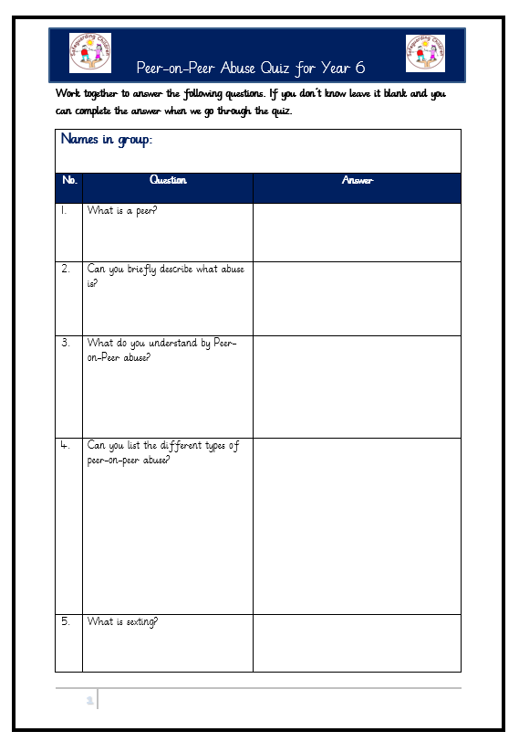
Quiz time
Work with a partner or in a three.
Answer as many questions as possible.
We will go over the answers at the end.
Don’t worry you cant get it wrong.

