Slide 1
Being Respectful

Slide 2
At Teagues Bridge Primary School we all try to follow the Whale Rules to make sure everyone is happy and safe.

Slide 3
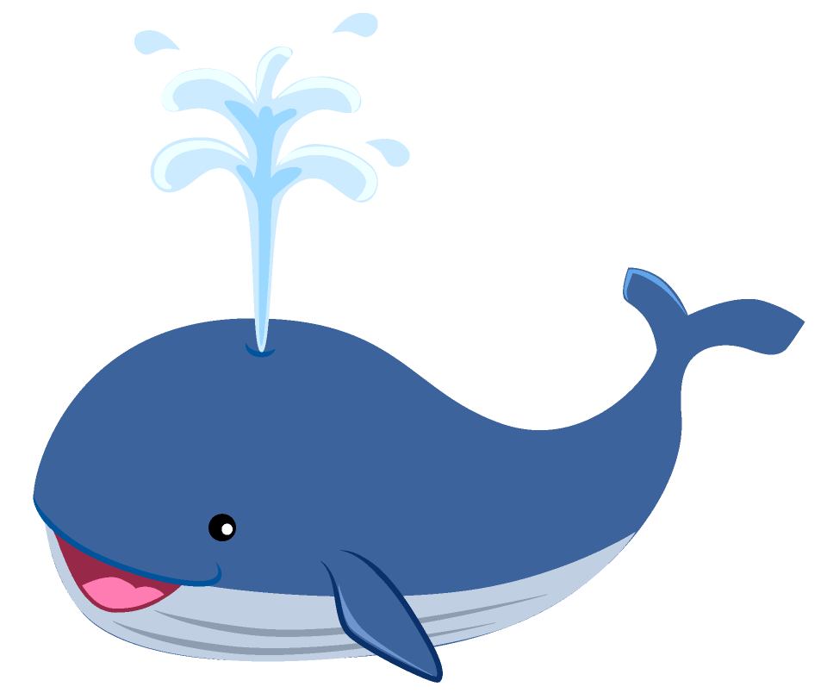
The Whale Rules are: Work sensibly & calmly at all times Help other in the classroom & outside Always be polite & respectful Listen carefully to all staff & each other Everyone has the right to feel safe

Slide 4
One of our core values is RESPECT. We respect everyone at Teagues Bridge.

Slide 5
There are lots of different people in our school and it is important that we are kind and respectful to each other.

Slide 6
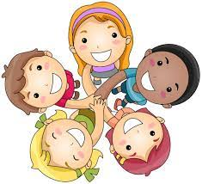
Being respectful means: - only using kind words - following the rules - following instructions from adults - being polite - speaking calmly

Slide 7
Being unkind, saying mean things, using inappropriate language and passing notes are not respectful actions and will not be tolerated at Teagues Bridge.

Slide 8
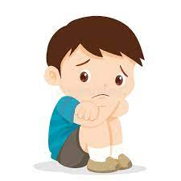
Saying and writing unkind and inappropriate things is wrong. They hurt other people and can make them feel sad or uncomfortable.

Slide 9
If we hear or see anyone saying unkind things or passing notes, we will tell an adult immediately and the adult will deal with it.

Slide 10
We will tell an adult immediately. We will not pass it on to other children, this is also wrong.

Slide 11
At Teagues Bridge we will work together to stamp out peer-on-peer abuse and ensure everyone is treated with respect.

