Slide 1
Creating a culture of

Slide 2
Rules are everywhere
There are rules that need to be followed wherever you go…
At school
At clubs
On the roads
At home
In the shops
Plus many more!

Slide 3
Why do we have rules?
Rules and laws keep us safe.
Rules keep everyone happy and healthy.
Rules teach us right from wrong.
We have rules in school so that everyone has a fair chance to learn.

Slide 4
The Whale Rules
The Whale Rules are: Work sensibly & calmly at all times Help others in the classroom & outside Always be polite & respectful Listen carefully to all staff & each other Everyone has the right to feel safe

Slide 5
Our Values
As well as the Whale Rules, we also have our core values at Teagues Bridge.
The main core value is RESPECT.

Slide 6
Being Respectful
There are lots of different people in our school and it is important that we are kind and respectful to each other.
Being respectful means: - only using kind words - following the rules - following instructions from adults - being polite - speaking calmly

Slide 7
Being Respectful
Being unkind, saying mean things, using inappropriate language and passing notes are not respectful actions and will not be tolerated at Teagues Bridge.

Slide 8
Why is saying unkind things, making inappropriate comments, hurting others and passing notes wrong?

Slide 9
If you hear or see someone being unkind or saying something inappropriate, what should you do?

Slide 10
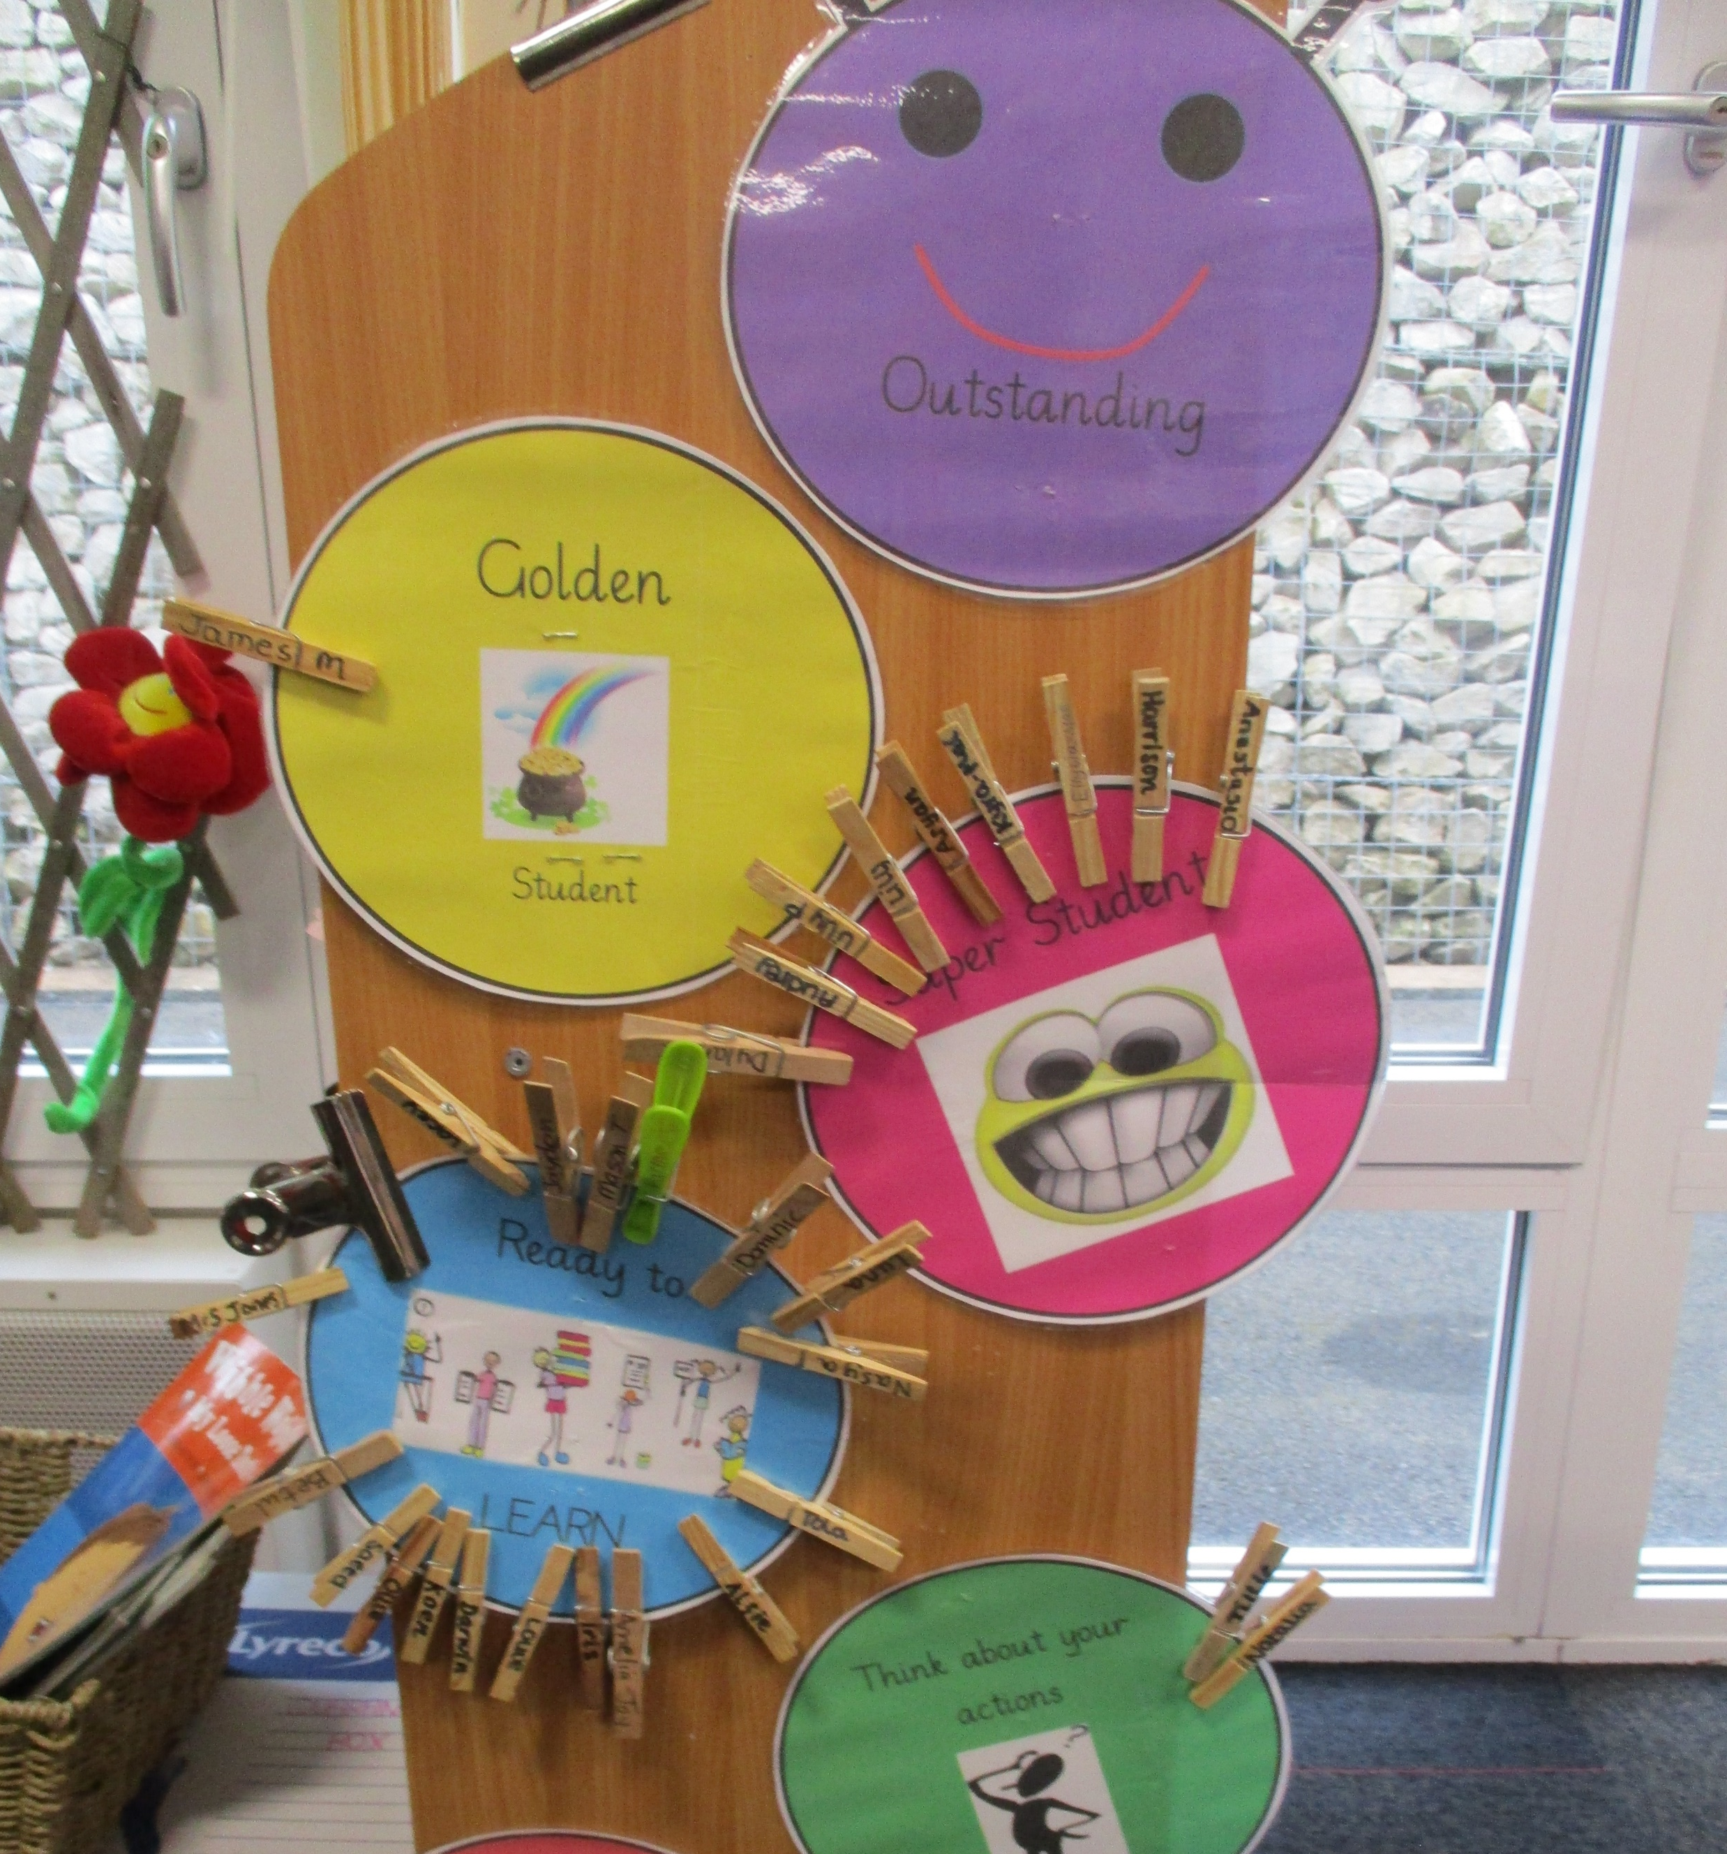
Consequences
If you follow the Whale rules and are respectful, your peg will be moved up.
If you break the Whale rules or are disrespectful your peg will be moved down.

Slide 11
Consequences
If you say inappropriate things, you will be given a yellow card and receive an internal exclusion.

Slide 12
By following the Whale Rules and being respectful, we will make Teagues Bridge a happy and safe place for everyone.

