Slide 1
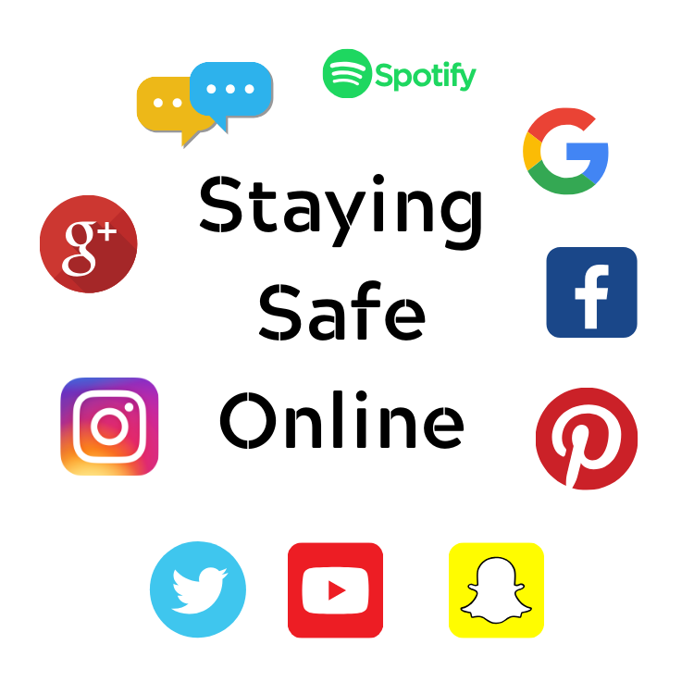
Building a positive digital presence – your board as ambassadors
sian.deane1@taw.org.uk

Slide 2
Why online safety?
Each year in the UK around 200 school-age children end their own lives, many of whom will have been adversely affected by what they have encountered online. Molly Russell’s inquest has shown us how the algorithmic amplification of online harms can too easily lead to tragedy. https://www.bbc.co.uk/iplayer/episode/p0d2brzr/molly-social-media-and-me

Slide 3
Amanda Spielman July 2022
Because for many young people social media is their news stand, radio and television in one, information is credible when “everyone is sharing it,” not when it’s properly sourced and evidenced. So inevitably misinformation becomes endemic and is then reinforced by the popular and influential kids.
That is a challenge for teachers – but it’s also a great opportunity to tackle misinformation head-on and make children more savvy about the content they come across. And the more knowledge children possess, the easier it is for them to spot what’s real and what’s fake and to question sources of information.

Slide 4
The Coroner’s Report – Molly Russell
The conclusion of the inquest was “Molly Rose Russell died from an act of self-harm whilst suffering from depression and the negative effects of on-line content”. The medical cause of death was 1a Suspension
https://www.judiciary.uk/wp-content/uploads/2022/10/Molly-Russell-Prevention-of-future-deaths-report-2022-0315_Published.pdf

Slide 5
Verdict
Molly appeared a normal healthy girl who was flourishing at school, having settled well into secondary school life and displayed an enthusiastic interest in the Performing Arts. However, Molly had become depressed, a common condition affecting children of this age. This then worsened into a depressive illness. Molly subscribed to a number of online sites. At the time that these sites were viewed by Molly some of these sites were not safe as they allowed access to adult content that should not have been available for a 14-year-old child to see. The way that the platforms operated meant that Molly had access to images, video clips and text concerning or concerned with self-harm, suicide or that were otherwise negative or depressing in nature. The platform operated in such a way using algorithms as to result, in some circumstances, of binge periods of images, video clips and text some of which were selected and provided without Molly requesting them.

Slide 6
Verdict
These binge periods, if involving this content are likely to have had a negative effect on Molly. Some of this content romanticised acts of self- harm by young people on themselves. Other content sought to isolate and discourage discussion with those who may have been able to help. Molly turned to celebrities for help not realising there was little prospect of a reply. In some cases, the content was particularly graphic, tending to portray self harm and suicide as an inevitable consequence of a condition that could not be recovered from. The sites normalised her condition focusing on a limited and irrational view without any counterbalance of normality. It is likely that the above material viewed by Molly, already suffering with a depressive illness and vulnerable due to her age, affected her mental health in a negative way and contributed to her death in a more than minimal way.

Slide 7
Coroner’s Concerns
There was no separation between adult and child parts of the platforms or separate platforms for children and adults.
There was no age verification when signing up to the on-line platform.
That the content was not controlled so as to be age specific.
That algorithms were used to provide content together with adverts.
That the parent, guardian or carer did not have access, to the material being viewed or any control over that material.
That the child's account was not capable of being separately linked to the parent, guardian or carer's account for monitoring.

Slide 8
Coroner’s recommendations
I recommend that consideration is given by the Government to reviewing the provision of internet platforms to children, with reference to harmful on-line content, separate platforms for adults and children, verification of age before joining the platform, provision of age specific content, the use of algorithms to provide content, the use of advertising and parental guardian or carer control including access to material viewed by a child, and retention of material viewed by a child.
I recommend that consideration is given to the setting up of an independent regulatory body to monitor on-line platform content with particular regard to the above.
I recommend that consideration is given to enacting such legislation as may be necessary to ensure the protection of children from the effects of harmful on-line content and the effective regulation of harmful on-line content.
Although regulation would be a matter for Government I can see no reason why the platforms themselves would not wish to give consideration to self-regulation taking into account the matters raised above.

Slide 9
Following the inquest – The Molly Rose Foundation
A range of resources were provided for individuals, parents and staff to talk about the about online use and things that you can do to stay safe as well as highlighting the support options that are available.
Specific resources for primary and secondary
https://mollyrosefoundation.org/resources/primary-school-resources/
https://mollyrosefoundation.org/resources/secondary-school-resources/

Slide 10
Online Safety Bill
The Bill introduces new rules for firms which host user-generated content, i.e. those which allow users to post their own content online or interact with each other, and for search engines, which will have tailored duties focussed on minimising the presentation of harmful search results to users.
Those platforms which fail to protect people will need to answer to the regulator, and could face fines of up to ten per cent of their revenues or, in the most serious cases, being blocked.
All platforms in scope will need to tackle and remove illegal material online, particularly material relating to terrorism and child sexual exploitation and abuse.
Platforms likely to be accessed by children will also have a duty to protect young people using their services from legal but harmful material such as self-harm or eating disorder content. Additionally, providers who publish or place pornographic content on their services will be required to prevent children from accessing that content.
The largest, highest-risk platforms will have to address named categories of legal but harmful material accessed by adults, likely to include issues such as abuse, harassment, or exposure to content encouraging self-harm or eating disorders. They will need to make clear in their terms and conditions what is and is not acceptable on their site, and enforce this.

Slide 11
Online Safety Bill 27.11.22
Plans to make encouraging self-harm online illegal have been backed by a charity set up in memory of a teenager who died after viewing content related to suicide, depression and anxiety.
The Molly Rose Foundation - established after the death of Molly Russell - said the proposal to amend the Online Safety Bill appeared to be a "significant move".
The update will outlaw communications that encourage people to physically harm themselves - in line with laws on communications that encourage suicide.
The Department for Culture, Media and Sport (DCMS) said the update was influenced by the tragic death of schoolgirl Molly, 14 - who died following "an act of self-harm while suffering from depression and the negative effects of online content", an inquest heard.
Culture Secretary Michelle Donelan has vowed to bring to justice "abhorrent trolls encouraging the young and vulnerable to self-harm".
"I am strengthening our online safety laws to make sure these vile acts are stamped out and the perpetrators face jail time," she said.
And she warned social media firms can "no longer remain silent bystanders".(Sky News)

Slide 12
Online safety and the under 5s
Most social media and gaming platforms require users to be 13-years-old or older. However, Ofcom’s 2022 report found that 21% of 3-4-year-olds and 33% of 5-7-year-olds already had a social media profile. Only 42% of parents in the same report could identify the correct minimum age for having a social media account. Children at this age don’t understand the reasons behind age requirements. So, it’s important to teach them.
Inappropriate content can include anything not suitable for a child’s age such as:
pornographic videos or images
nasty language
hate speech
content promoting eating disorders and self-harm
images or videos showing violent or cruel acts
sexism or misogynistic content

Slide 13
Books for 3-7

Slide 14
Books for KS2

Slide 15
Books for KS3

Slide 16
More resources and lesson plans
https://kentesafety.wordpress.com/2015/06/05/online-safety-storybooks/ - further book titles
https://www.lincolnshire.gov.uk/directory-record/64942/online-safety-resources-for-key-stage-3-and-4-ks3-and-ks4-ages-11-to-18- - includes online bullying, sexting, online relationships, pressures of a digital world, privacy, digital footprint, self-esteem, consequences to our behaviour and where support can be accessed should they come across an issue online
https://www.internetmatters.org/schools-esafety/ - support for parents, teachers and pupils

Slide 17
Online safety and the under 5s
Children in Early Years are unlikely to search for this content online. However, while parental controls and restrictions will usually filter out inappropriate content, some may slip through. It’s important to teach parents how to monitor their child’s online use at this age to ensure they are not harmed by content that is not appropriate for their age.
How can your board support this?

Slide 18
Resources
Safeguarding children and protecting professionals in early years settings: online safety considerations (for managers and practitioners)
Keeping children safe in education 2022
Smartie the Penguin
Little Bird’s Internet Security Adventure
https://foundationyears.org.uk/2022/10/foundation-years-vodcast-on-online-safety/
https://www.virginmedia.com/blog/online-safety/childrens-internet-safety-test/
https://help-for-early-years-providers.education.gov.uk/safeguarding-and-welfare/internet-safety

Slide 19
Resources for 3-7 year olds
https://www.childnet.com/resources/digiduck-stories/digiducks-big-decision/
https://www.childnet.com/resources/online-safety-activities-you-can-do-from-home/for-3-7-year-olds/
https://www.thinkuknow.co.uk/professionals/resources/jessie-and-friends/
https://www.thinkuknow.co.uk/4_7/
https://click.actionforchildren.org.uk/?gclid=Cj0KCQiAsoycBhC6ARIsAPPbeLtS5dLhJsFwxeRz_Rz3vR5TeZT2_pX9zqJIdI2jLhKbisNKCYSb3dsaAlikEALw_wcB

Slide 20
Resources for 7-11 year olds
https://www.childnet.com/resources/the-adventures-of-kara-winston-and-the-smart-crew/
https://www.childnet.com/resources/online-safety-activities-you-can-do-from-home/for-7-11-year-olds/
https://click.actionforchildren.org.uk/?gclid=Cj0KCQiAsoycBhC6ARIsAPPbeLtS5dLhJsFwxeRz_Rz3vR5TeZT2_pX9zqJIdI2jLhKbisNKCYSb3dsaAlikEALw_wcB

Slide 21
Online safety resources KS3/4
https://click.actionforchildren.org.uk/?gclid=Cj0KCQiAsoycBhC6ARIsAPPbeLtS5dLhJsFwxeRz_Rz3vR5TeZT2_pX9zqJIdI2jLhKbisNKCYSb3dsaAlikEALw_wcB
https://www.lincolnshire.gov.uk/directory-record/64942/online-safety-resources-for-key-stage-3-and-4-ks3-and-ks4-ages-11-to-18-
https://www.kelsi.org.uk/child-protection-and-safeguarding/e-safety/e-safety-classroom-materials
https://www.internetmatters.org/schools-esafety/secondary/

Slide 22
Pupils with SEND
https://www.nspcc.org.uk/keeping-children-safe/online-safety/online-safety-families-children-with-send/
https://www.kelsi.org.uk/__data/assets/pdf_file/0011/74576/Online-Safety-for-SEND.pdf
https://www.internetmatters.org/inclusive-digital-safety/advice-for-parents-and-carers/supporting-children-with-send/
https://saferinternet.org.uk/blog/looking-at-online-safety-with-young-people-with-send-new-resource-from-childnet
https://www.childnet.com/resources/know-it-all-for-teachers-sen/

Slide 23
Support for parents
https://www.childnet.com/resources/video-lessons/the-s-rule/
https://www.nspcc.org.uk/keeping-children-safe/online-safety/talking-child-online-safety/
https://www.youtube.com/watch?v=ef_eRL_z4XQ

Slide 24
What to do if something upsets you online
https://www.internetmatters.org/issues/inappropriate-content/

Slide 25
Anna Freud – Classroom Wellbeing Toolkit
This evidence-based toolkit, created in partnership with the Early Intervention Foundation (EIF), will help secondary school staff take steps to improve students’ mental health and wellbeing through everyday practices.
This new resource will help build teachers' confidence to address the needs of their students, covering five strategy areas on:
building supportive relationships
creating a classroom environment where all students feel they belong
promoting good mental health
responding to stress, low mood and anxiety
preventing bullying, cyberbullying and sexual harassment.
https://www.annafreud.org/schools-and-colleges/resources/classroom-wellbeing-toolkit/

Slide 26
Co-production with pupils and parents
https://360safe.org.uk/
https://swgfl.org.uk/topics/digital-wellbeing/
https://saferinternet.org.uk/guide-and-resource/teachers-and-school-staff/teaching-resources

Slide 27
Co-production with pupils
Writing age appropriate policies
Co-producing pupil/student workshops, assemblies and workshops/leaflets etc for parents
Pupils/Students working with staff to unpick the content of films and videos to deliver clear messages about online abuse
Pupils driving campaigns for pupils to come forward where they are experiencing harmful content online
Pupils working with staff to improve the safeguarding culture in the setting(modelling how to come forward with concerns)
Promoting the Active Bystander culture
Support for those using/accessing/sending harmful content
Making their own online film for the website
How to set parental control videos for parents

Slide 28
Ask for help

Slide 29
Ask for help

Slide 30
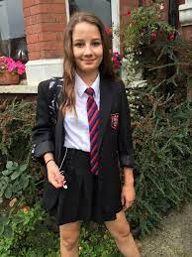
Molly Rose Foundation
Following the tragic loss of Molly in 2017, the Russell family and their friends set-up a charitable foundation in Molly’s memory
The aim of the Molly Rose Foundation is suicide prevention, targeted towards young people under the age of 25.
MRF wants to help reach those at risk of suicide and connect them to the help, support, and practical advice they need
https://mollyrosefoundation.org/resources/
If you’re struggling just text MRF to 85258 so you can speak to a trained volunteer from Shout, the UK’s Crisis Text Line service

Slide 31
Resources
https://digitalyouthindex.uk/young-peoples-digital-lives/
https://www.ofcom.org.uk/news-centre/2022/a-third-of-children-have-false-social-media-age-of-18
https://www.internetmatters.org/
https://www.internetmatters.org/inclusive-digital-safety/
https://www.twinkl.co.uk/resources/eyfs-resource-archive/early-years-ict/early-years-internet-safety
https://projectevolve.co.uk/toolkit/

Slide 32
NSPCC FREE ONLINE Workshops
https://www.nspcc.org.uk/keeping-children-safe/online-safety/free-online-safety-group-workshops/

