Slide 1
Supporting children’s understanding of Domestic Abuse
Children’s safeguarding board network meeting
15th March 2022

Slide 2
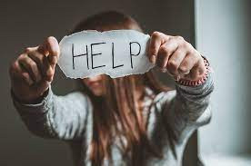
Domestic Abuse – a reminder
One in seven (14.2%) children and young people under the age of 18 will have lived with domestic violence at some point in their childhood, with damaging impact on every area of children and young people’s lives.
In the financial year 2018-19, 64.1% of women in refuge services had children and 8.2% were pregnant.

Slide 3
What safeguarding boards can do
Challenge the myths that perpetuate domestic abuse.
Support children to seek help and safety.
Model and promote healthy, non-violent
relationships.

Slide 4
Research has shown that there is wide acceptance of abuse among young people in the UK
According to Girlguiding’s Girls’ Attitudes
Survey 2013, seven out of ten girls aged 13 and over have experienced intrusive forms
of sexual harassment, such as jokes, taunts and unwanted sexual attention.12

Slide 5
Girls’ Attitude Survey
The Girls’ Attitudes Survey 2020, revealed that eight out of ten girls and young women aged 11 to 21 (80%) have thought about changing their appearance

Slide 6
University students
In a study by the charity Brook and the student database Dig-In, conducted in January 2019 with students at university, 56% of respondents said they had experienced unwanted sexual behaviours
at university, but only 15% realised that these behaviours counted as sexual harassment. Most of the incidents were perpetrated by other students and only around 5% of survivors reported it.

Slide 7
Sexual harassment
One in three 16-18 year old girls say
they have experienced unwanted sexual
touching at school.
59% of young women aged 13-21 say they
had faced some form of sexual harassment
at school or college in the past year (at the
time of survey)

Slide 8
Rape and derogatory language
600 rapes in schools were reported to
police between 2012 and 2015 - an average
of a rape every day of the school year.
Nearly three-quarters (71%) of all 16-18
year olds say they hear terms like ‘slut’
or ‘slag’ used towards girls at school on a
regular basis.

Slide 9
Signs of domestic abuse
unexplained absences or lateness – either from staying at home to protect their mother or hide their injuries, or because they are prevented from attending the setting;
children and young people attending the school or group when ill rather than staying at home;
children and young people not completing their homework or home-based activities, or making constant excuses, because of what is happening at home;

Slide 10
Other indicators
children and young people who are constantly tired, on edge and unable to concentrate through disturbed sleep or worrying about what is happening at home;
children and young people displaying difficulties in their cognitive performance;
children and young people whose behaviour and personality changes dramatically;
children and young people who become quiet and withdrawn and have difficulty in
developing positive peer relations;
children and young people displaying disruptive behaviour or acting out violent thoughts with little empathy for victims;
children and young people who are no trouble at all.

Slide 11
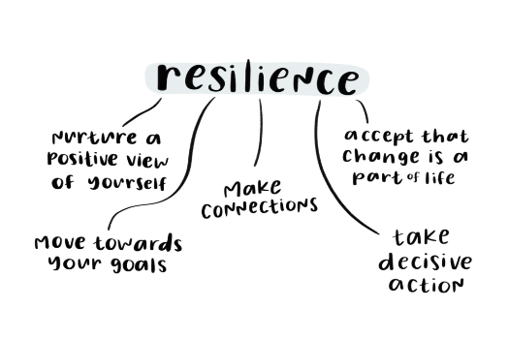
Resilience and the voice of the child
It is important to note that children and young
people are resilient and are able to develop
coping mechanisms that allow them to progress
and develop through life.
It’s important to
remember that children and young people
have agency and know the situations they are
in better than us; they should have their views
respected and should be listened to.

Slide 12
Age-appropriate themes KS1 and 2 – Expect Respect
Looking at and challenging gender expectations
Friends, secrets and people who can help us
Gender, careers and assumptions
Resolving conflict and where to get help
Examining violence, excuses and responsibility
Secrets and stories
Court room game
My online identity

Slide 13
Age-appropriate themes KS3 and 4 – Expect Respect
Unwritten rules and managing conflict
My online identity and footprint
Introduction to domestic violence and abuse
Online behaviours
Myths and realities
Behaviours – OK or not?
Verbal and non-verbal consent
Domestic abuse – it’s criminal
Understanding consent
Young people and coercive control
Consent and online relationships

Slide 14
Challenging stereotypes in Early Years
1) Dogs Don’t Do Ballet by Anna Kemp and Sara Ogilvie
In this funny, touching book, Biff the dog longs to do ballet. After being told repeatedly that it’s not proper, he shows everyone that anyone can do anything, regardless of whether people approve or not.
2) The Paper Bag Princess by Robert Munsch and Michael Martchenko
The traditional prince and princess tale is turned on its head here. Princess Elizabeth is to marry Prince Ronald, but before their wedding day, he is taken by a dragon. Princess Elizabeth then goes on an action packed journey to rescue her Prince, much to his chagrin. The book also explodes the idea that girls should always be pretty and neatly dressed.
3) The Night Pirates by Peter Harris and Deborah Allwright
This is another book that defies traditional gender roles. Here the night pirates of the title are ‘rough tough little girl pirates.’ But it’s also an inclusive book. When Tom asks if he can come on the adventure, he is welcomed aboard the ship.
4) Princess Daisy and the Dragon and the Nincompoop Knights by Steve Lenton
A bit like The Paper Bag Princess, this book shows that a princess can be as adventurous, brave, clever and confident as any knight or prince.
5) I’m a Girl by Yasmeen Ismail
The girl protagonist in this picture book is always being mistaken for a boy because she likes to wear shorts and T shirts and run around outside. Then she meets a boy who likes dresses and playing make believe with dolls. Yet despite their differences, the pair find they have lots of things in common.

Slide 15
6) 10,000 Dresses by Marcus Ewart and Rex Ray
This is one of only very few books that features transgender identity and it does so with sensitivity. Beyond gender identification issues, there are clear messages about rejoicing in what makes us unique and embracing difference.
7) And Tango Makes Three by Justin Richardson, Peter Parnell and Henry Cole
Inspired by the behaviour of two real male penguins in Central Park Zoo, the story follows Roy and Silo’s longing to become parents. There has been a lot of opposition to the book, which celebrates gay parenting, and whether it should be given shelf space in school libraries. However, the authors tried to keep the story as close to the reality of the situation as they could. The only poetic license they use is to give Roy and Silo smiles when their chick arrives.
8) The Sissy Duckling by Harvey Fierstein and Henry Cole
This story challenges the idea that boys and girls have to behave in certain ways, but also shows the teasing and name calling that can follow if they are true to their interests and desires. The book emphasises that being yourself isn’t always the easiest route through life. The events of the picture book offer the reader the opportunity to think about what words such as sissy mean and what the intent behind these words is for those who use them.

Slide 16
9) Donovan’s Big Day by Leslea Newman and Mike Dutton
Donovan’s sense of excitement over his two mothers’ wedding day and his role in the ceremony is communicated through the bold and colourful illustrations. It’s a joyful book that views the day through a child’s eyes. For Donovan, there is no teasing or any such issues raised, just the sense of anticipation from being part of the big day.
10) The Great Big Book of Families by Mary Hoffman and Ros AsquithResearch shows that it’s important for children to see cultural representations of their own identity and family formation. This book attempts to show every permutation of modern day family in a vibrant and positive way.Park by Joe Griffiths and
11) Picnic in the Park by Joe Griffiths and Tony Pilgrim
This is another picture book that explores the diversity of family construction. Jason is having a birthday picnic in the park and as his friends arrives, he sees the different kinds of families they come from. It also has space for the child reader to draw their own family at the end of the story

Slide 17
Books to combat stereotyping at KS1 and lower KS2
Rosie Revere, Engineer by Andrea Beaty, David Roberts. This book is about a girl who dreams of becoming an inventor. This series also includes Ada Twist, Scientist and Iggy Peck, Architect.
Julián Is a Mermaid by Jessica Love-This book is about a girl who dreams of becoming an inventor. This series also includes Ada Twist, Scientist and Iggy Peck, Architect.

Slide 18
Books to combat stereotyping at KS1 and lower KS2
Morris Micklewhite and the Tangerine Dress by Christine Baldacchino, Isabelle Malenfant This book is about inclusion and acceptance and exploring who you are and what you like.
Interstellar Cinderella by Deborah Underwood, Meg Hunt - This book follows the story of Morris who likes to wear dresses and his peers reactions to it.
Pink Is for Boys by Robb Pearlman, Eda Kaban - Learn about gender expression and identity with this story and that you can be yourself.
Except When They Don't by Laura Gehl, Joshua Heinsz - This book reframes the stereotypical blue/pink gender binary and empowers kids, and their grown-ups, to express themselves in every colour of the rainbow

Slide 19
Books to combat stereotyping at KS1 and lower KS2
Shark Lady by Jess Keating, Marta Álvarez Miguéns - This rhyming book reminds children they can play with the toys they want to.
This is Our House by Michael Rosen, Bob Graham - This true story shares how Eugenie Clark became known as the shark lady.
Curious Pearl, Science Girl 4D by Eric Braun, Stephanie Dehennin - This book explores sharing, exclusion, and discrimination.

Slide 20
Books to combat stereotyping at KS2 and lower KS3
Ada's Ideas by Fiona Robinson - This book tells the story of Ada Lovelace, the World's First Computer Programmer
Tara Binns by Lisa Rajan, Eerika Omiyale
-This series of books contains some Big Cat Phonics books. They are designed to inspire children to think about different careers.
The Turbulent Term of Tyke Tiler by Gene Kemp
This classic book explores gender stereotypes as the character of Tyke unfolds.
Amazing Grace by Mary Hoffman - Grace’s love of reading and role-play motivates her to audition for the role of Peter Pan in the school play. The other children tell her she can’t play a boys part. Her mama and Nana tell her she can be anything she wants, helping her find the confidence to audition and win the role of Peter Pan.

Slide 21
Books to challenge stereotyping at KS2 and lower KS3
The Bluest of Blues by Fiona Robinson - A picture book biography of botanist and photographer Anna Atkins, the first person to publish a book of photography. Her scientist father raised Anna to be a scientist.
The Boy Who Grew Flowers by Jen Wojtowicz - Rink Bowagon is ignored by his teacher and classmates because he sprouts flowers from his body. He notices the new girl wears a flower in her hair and has one leg shorter than the other, so Rink makes her a special pair of shoes. Excited, she invited him to the school dance where he discovers the flower behind her ear is his.

Slide 22
Books to challenge stereotyping at KS2 and lower KS3
Drum Dream Girl: How One Girl’s Courage Changed Music by Margarita Engle - Cuba’s traditions don’t allow female drummers. A young girl tries to keep her passion a secret. But when others hear her music they dance and sing to her rhythm. This passion changes tradition and anyone who dreams of playing the drums, no matter their gender, can.
Emmeline Pankhurst by Lisbeth Kaiser - As a political activist, Emmeline Pankhurst dedicated her life to the fight for women’s equality. She organised the suffragette movement in the UK and was instrumental in women gaining the right to vote. The book includes a profile of Mrs. Pankhurst’s life accompanied by historical photos and a timeline.
Hidden Figures by Margot Lee Shetterly - Hidden Figures tells the inspirational story of four black women who worked at NASA in the 1940s. Their intelligence and determination changed the world by putting a man on the moon.

Slide 23
Questions to ask
What does the word ‘stereotypes’ mean?
What is gender stereotyping?
What is gender identity?
Where do you think gender stereotypes come from?
Why do you think there gender stereotyping exists?
Have you come across gender stereotypes in books you have read? What examples can you think of?
What female gender stereotypes can you think of?
What male gender stereotypes can you think of?
How do you think gender stereotypes in books affect the reader?
Do you think male and female characters are treated in the same way? For example, could [character] have been male or female? Explain your answer?
https://liftinglimits.org.uk/families/

Slide 24
Key Stage 3
Do your own gender balance book test. Simply pick ten books from your bookshelf or book corner and look at the gender balance:
How many male characters are there?
How many female characters are there?
Who gets to speak?
Who gets to act?
What are male and female characters shown doing?
Who are the heroes?
Who are the villains?
http://www.lettoysbetoys.org.uk/constructing-bias-the-wonky-world-of-picture-books/

Slide 25
Challenging stereotypes – Anna Freud
https://www.teachprimary.com/learning_resources/view/pshe-lesson-plan-challenging-stereotypes

Slide 26
Conflict resolution – through peer mentors and guiding peers
1. Understanding feelings
2. Using an Immediate Calming Strategy
3. Scale the problem
4. Expressing feelings and needs
5. Actively listening and reflecting
6. Brainstorming solutions
7. Choosing solutions
8. Moving on

Slide 27
DA and the law
Using the British Values:
Democracy.
Rule of Law.
Respect & Tolerance.
Individual Liberty.

Slide 28
Domestic Abuse Act 2021
Children as victims of domestic abuse
(1)This section applies where behaviour of a person (“A”) towards another person (“B”) is domestic abuse.
(2)Any reference in this Act to a victim of domestic abuse includes a reference to a child who—
(a)sees or hears, or experiences the effects of, the abuse, and
(b)is related to A or B.
(3)A child is related to a person for the purposes of subsection (2) if—
(a)the person is a parent of, or has parental responsibility for, the child, or
(b)the child and the person are relatives.
(4)In this section—
“child” means a person under the age of 18 years;
“parental responsibility” has the same meaning as in the Children Act 1989 (see section 3 of that Act);
“relative” has the meaning given by section 63(1) of the Family Law Act 1996.

Slide 29
Books on Domestic Abuse
Mommy’s Black Eye By William George Bentrim - Bearly Tolerable Publications, 2012
A Family That Fights By Sharon Chesler Bernstein - Albert Whitman & Company, 1991
Something Is Wrong at My House By Diane Davis - Parenting Press, 2010

Slide 30
Books on Domestic Abuse
Hear My Roar: A Story of Family Violence By Gillian Watts - Annick Press, 2009
The Day My Daddy Lost His Temper By Dr. Carol Santana McCleary - Self-published, 2014

Slide 31
Books on beyond words for SEND

Slide 32
1. Anger Is Okay Violence Is NOT (Julie K. Federico)
Federico has a long list of books that are great resources for children dealing with difficult topics. This book helps children find alternative behaviors instead of getting angry. It’s hidden message deals with domestic violence.
2. Some Secrets Should Never Be Kept (Jayneen Sanders)
This picture book talks about body safety in a nonthreatening and age-appropriate manner. It’s beautifully illustrated by Craig Smith and written for children up to 12 years old. Adults can use the discussion questions in the back of the book for added conversation about the topic.
3. A Terrible Thing Happened (Margaret M. Holmes & Sasha J. Mudlaff)
Sherman sees something awful happen. He gets nervous and anxious, but when he talks about it with a counselor, he feels better. This book supports mental health therapy. It’s not just about witnessing domestic violence, but natural disasters, gang violence or accidents.
4. The Day My Daddy Lost His Temper (Dr. Carol Santana McCleary, PsyD
This book is part of the Empowering Kids Series, which helps children learn to verbalize their experience and feelings. This helps the healing process and reduces feelings of shame by letting children know they aren’t alone.
5. The Night Dad Went to Jail: What to Expect When Someone You Love Goes to Jail (Melissa Higgins)
When the police arrest a parent, the child can feel a multitude of things, from fear to anger and guilt. This well-written book helps kids understand it wasn’t their fault.
6. Lizzy Lives in an Angry House: Learning to Thrive in the Midst of an Angry Environment (Karen Addison, MSPH)
This book is a resource for children and adults who are living in an unhealthy relationship. It’s written to help children understand how to make sense of the situation and still love the abusive adult. Addison gives children ways to keep themselves safe while still speaking up. It’s not necessarily a picture book in the truest sense, but it offers hope and healing.

Slide 33
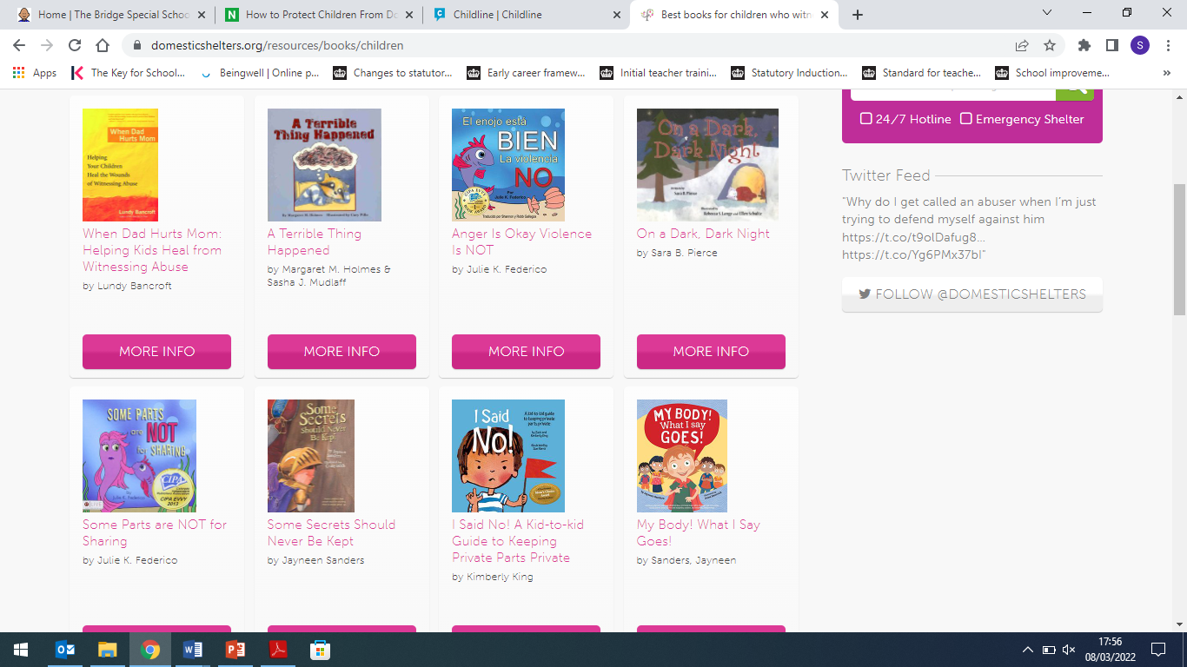

Slide 34
https://www.whatdowedoallday.com/childrens-books-that-address-domestic-violence/

Slide 35
True co-production
Are children’s ideas and views used to make changes or do we drive our own agenda?
Do we give children feedback on the impact of what they have done?
Are we missing out on a rich data source?

Slide 36
Co-production
Booklets on healthy friendships, relationships, consent, managing and resolving conflict
Running workshops on relationships, conflict, consent
Writing child friendly policies linked to behaviour, bullying, equality and the protected characteristics

Slide 37
Domestic Abuse Toolkit for all ages
http://thehideout.org.uk/wp-content/uploads/2015/07/spiralling_toolkit.pdf#page=95&zoom=100,0,198

Slide 38
Resources
http://thehideout.org.uk/
https://www.childline.org.uk/ 0800 1111
For parents
Relate 0300 003 0396 You can talk to Relate about your relationship, including issues around domestic abuse.
National Domestic Violence Helpline 0808 2000 247 A 24 hour free helpline run in partnership between Women's Aid and Refuge.
Men's Advice Line 0808 801 0327 Advice and support for men experiencing domestic violence and abuse.
National LGBT+ Domestic Abuse Helpline 0800 999 5428 Emotional and practical support for LGBT+ people experiencing domestic abuse

Slide 39
Free domestic abuse training - The Haven Refuge – Wolverhampton
Severn Training and Schools Alliance is offering free domestic training abuse for schools:
Friday 25th March
Monday 28th March
Monday 4th April
Tuesday 5th April
Thursday 7th April
9.30am to 3pm with lunch and breaks – groups of 10, all online

Slide 40
Supporting Children, Young People and their Families who have been subjected to Domestic Abuse
Rationale:
To educate professionals in supporting children, young people and their families who are being subjected to Domestic Abuse by using strength-based approaches in assessing risk and identifying that early intervention is key.

Slide 41
Learning outcomes
Identify what the impact of Domestic Abuse does to children, young people and their families.
Recognise how the Domestic Abuse Act 2021 protects children and young people.
Identify the risks to children and young people being subjected to Domestic Abuse.
Understand the importance of early identification, intervention, and prevention.
Indicate the need to apply the Think Family approach into your practice to enhance assessment and safety.
Identify your role in supporting children, young people and their families being subjected to Domestic Abuse.
Develop strategies to feel confident to be professionally curious to ask about Domestic Abuse.
Respond to a disclosure of Domestic Abuse sensitively and in a way that promotes the safety of victims and families.
How and where to refer.
Case studies.

Slide 42
Support resources
Support resources:
Overview of training with sources and referral details.
Q&A session to cover any issues.
Ongoing after event sessions
Feedback on events to Severn Training with ongoing changes as required.
Group size of up to 10 attendees – this will allow interaction throughout, effective discussions around case studies and Q&A.

Slide 43
RSHE support materials
Remember the DfE training materials and resources
https://www.gov.uk/government/publications/relationships-education-relationships-and-sex-education-rse-and-health-education/annex-b-resources-for-relationships-education-relationships-and-sex-education-rse-and-health-education
Training modules
Primary - https://www.gov.uk/guidance/teaching-about-relationships-sex-and-health#primary-teacher-training-modules
Secondary - https://www.gov.uk/guidance/teaching-about-relationships-sex-and-health#secondary-teacher-training-modules

