Slide 1
Pressure Ulcers and Adult Safeguarding
Rachel Jones, Deputy Designated Adult Safeguarding Professional

Slide 2
When is a pressure ulcer a safeguarding matter?
[…] If it appears to local authorities that the person is experiencing, or at risk of, abuse or neglect, they must carry out a safeguarding enquiry and decide with the adult in question what action, if any, is necessary and by whom.
The decision to carry out a safeguarding enquiry does not depend on the person’s eligibility, but should be taken wherever there is reasonable cause to think that the person is experiencing, or is at risk of, abuse or neglect. Where this is the case, a local authority must carry out (or request others to carry out) whatever enquiries it thinks are necessary in order to decide whether any further action is necessary.
DoH&SC (2021) Care and Support Statutory Guidance 6.54 & 6.55

Slide 3
Where there is poor, neglectful care or practice, resulting in pressure sores… then an employer-led disciplinary response may be more appropriate; but this situation will need additional responses such as clinical intervention to improve the care given immediately and a clinical audit of practice.
[…] For example, health professionals should undertake enquiries and treatment plans relating to medicines management or pressure sores.
DoH&SC (2021) Care and Support Statutory Guidance,14.42 & 14.82

Slide 4
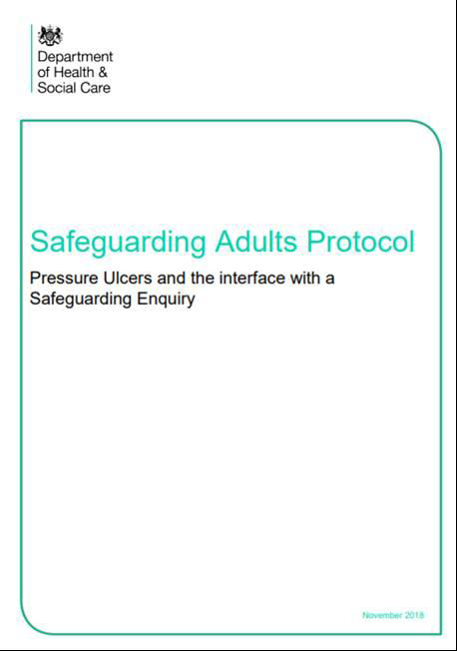
So are pressure ulcers a safeguarding matter???????
Safeguarding adults protocol: pressure ulcers and the interface with a safeguarding enquiry

Slide 5
Aim of the Guidance
To assist practitioners and managers to provide a caring, speedy and appropriate response to individuals at risk of developing pressure ulcers.
Where a pressure ulcer does occur the guidance provides a clear process to manage the removal and reduction of harm to the individual, whilst considering if an adult safeguarding response under Section 42 of the Care Act is necessary.
Pressure ulcers are largely preventable and cause distress to individuals and their families.
Prevention is key.
Notes:
Prevention of pressure ulcers is not only ideal but, in most cases, perfectly possible. Taking a proactive approach will reduce harm to individuals.

Slide 6
What must happen:
It is vital that any assessment including risk assessments, address the likelihood of pressure ulcers developing and what action must be taken to prevent them. All staff should receive training in prevention and signs of developing pressure ulcers.
Practitioners and managers responsible for carrying out assessments and arranging services need to know how to access clinical advice to support care planning and do this at the earliest opportunity to prevent or respond to pressure ulcers.
All incidences of pressure ulcers should be investigated to support organisational and system learning and appropriate actions to prevent further occurrences.
Notes:
Preventing pressure ulcers and a prompt response to signs of a pressure ulcer developing is a real opportunity to improve the lives and individuals and their families and to improve the quality of life for a great many people.

Slide 7
Key Messages
Protocol aim – prevention of pressure ulcers wherever possible
Providing a process for the clinical and management of the removal and reduction of harm to the individual
Focus on removal of harm = speedy clinical intervention.
Considers if an adult safeguarding response under Section 42 of the Care Act 2014 is necessary.
The response to the presence of pressure ulcers should involve the individual and their family, explaining the concerns and seeking their views.

Slide 8
Safeguarding Adults Protocol: Pressures Ulcers and the Interface with the Safeguarding Enquiry
Published Jan 2018 reviewed November 2018
Pressure ulcers (PU) primarily a matter for clinical review not a safeguarding enquiry
All pressure ulcers should result in review/learning
Provides guidance as to when a PU MAY require the raising of a safeguarding concern

Slide 9
Requirements when severe pressure damage occurs: multiple Grade 2s, G3/4 or ungradeable
Take immediate clinical action/seek advice
Raise internally as a safeguarding matter
Provide scrutiny and assurance
Determine if you need to raise a safeguarding concern

Slide 10
Six questions (Appendix 3, Decision Guide)
Has the patient or service user’s skin deteriorated to either category 3/4/unstageable or multiple sites of category 2 ulceration from healthy unbroken skin since the last opportunity to assess/visit?
2. Has there been a recent change in their clinical condition that could have contributed to skin damage? E.g. infection, pyrexia, anaemia, end of life care (Skin Changes at Life End), critical illness?
Notes:
*utilise Appendix 1: Guidance for completing the adult safeguarding decision guide to ensure that you are covering all key elements. This includes the consideration of:
History
Medical history
Monitoring of skin integrity
Expert advice on skin integrity
Care planning and implementation for management of skin integrity
Care provided in general (hygiene, continence, hydration, nutrition, medications)
Other possible contributory factors

Slide 11
Six questions
3. Was there a pressure ulcer risk assessment and reassessment with an appropriate pressure ulcer care plan in place and was this documented in line with the organisation’s policy and guidance?
4. Is there a concern that the pressure ulcer developed as a result of the informal carer ignoring or preventing access to care or services?

Slide 12
Six questions
5. Is the level of damage to skin inconsistent with the service user’s risk status for pressure ulcer development? E.g. low risk –category/ grade 3 or 4 pressure ulcer?
6a. Was the patient compliant with the care plan having received information regarding the risks of non-compliance?
(if person has capacity to consent to every element of the care plan)

Slide 13
Six questions
6b. Was appropriate care undertaken in the patient’s best interests, following the best interests’ checklist in the Mental Capacity Act Code of Practice? (supported by documentation, e.g. capacity and best interest statements and record of care delivered)
(if person has been assessed as not having capacity to consent to any or some of the care plan)

Slide 14
Outcome
If the score is 15 or above or based on professional discretion….
Raise a safeguarding concern (include Appendix 3)
This applies to all agencies and in all settings who are responsible for the care of the person
If transferring a person to another setting you will still need to raise the concern and share appendix and referral information with new service
*Record keeping of decisions and rationale in person’s record is essential*

Slide 15
Telford and Wrekin Safeguarding Partnership – Pressure Ulcer and Safeguarding Process

Slide 16
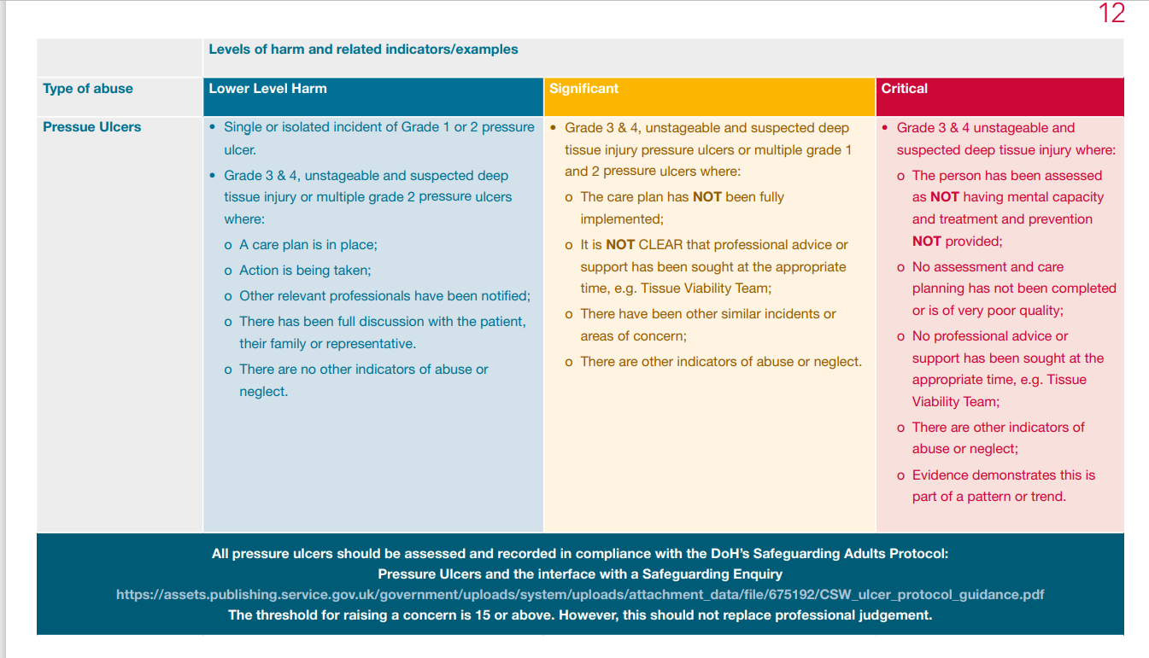
Notes:
The above table is an extract from TWSP’s, Safeguarding Threshold for Access to Safeguarding Services Matrix (July 2020)
Safeguarding Threshold of Needs Matrix - Telford and Wrekin Safeguarding Partnership (telfordsafeguardingpartnership.org.uk)
Guidance on the categories (Page 6)
Lower Level of Harm – These may not meet the threshold for a section 42 enquiry, however the actions may include advice, information, risk management, staff training, disciplinary or complaints procedures. Any actions taken should be recorded. However, if there are multiple ‘non-reportable’ incidents concerning the same service user/staff member/team consideration should be given as to whether a safeguarding concern should be raised. It may be advisable to discuss this with the organisational Adult Safeguarding Lead.
Significant – This means that it is likely to meet the threshold for a Section 42 enquiry. A safeguarding concern and consultation with the organisational Adult Safeguarding Lead is advisable.
Critical – This means that it is highly likely to result in an urgent safeguarding enquiry (known as a Section 42 Enquiry). It will be a serious criminal matter, and therefore immediate discussion with the police will be required.

Slide 17
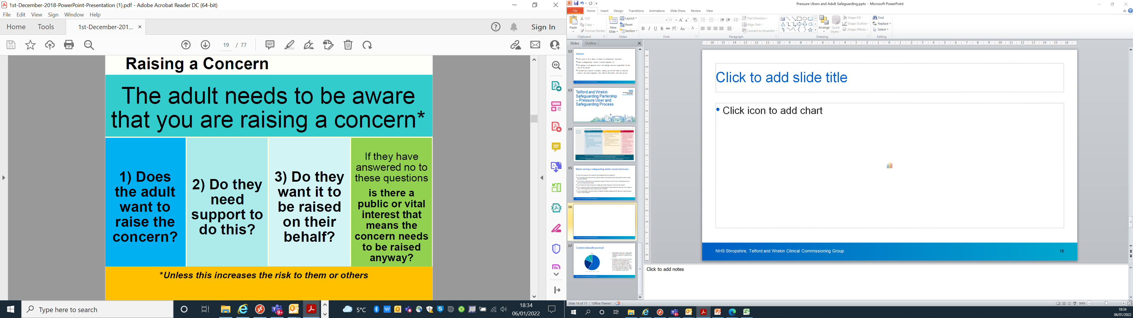

Slide 18
Before raising a safeguarding adults concern have you:
Used the pressure ulcer protocol and addressed the six questions?
Involved the adult with care and support needs in discussions about raising the concern or their representatives?
Is the adult consenting to you raising the concern? If not on what basis are you raising it (see previous slide)
Considered the signs of abuse or neglect and what impact it is having on the person?
Put in place action to reduce the risk to the person? What measures have you put in place to deal with the pressure ulcer, who have you involved?
Is the organisation using any other processes alongside safeguarding? E.g. employer-led disciplinary response, serious incident process or route cause analysis?

Slide 19
Checklist
Prevention
Training
Investigations
Access timely clinical advice
Ensure Care Plans are followed
Know when to raise a safeguarding concern

Slide 20
Resources
Telford and Wrekin Safeguarding Partnership: https://www.telfordsafeguardingpartnership.org.uk/site/index.php
Safeguarding Threshold of Needs Matrix - Telford and Wrekin Safeguarding Partnership as page 12 covers Pressure Ulcers
NHS - https://www.nhs.uk/conditions/pressure-sores/
Tissue Viability Society - https://tvs.org.uk/stop-pressure/
SCHT Tissue Viability Page which includes information, resources and the referral process: Wounds, ulcers & pressure sores - tissue viability services (shropscommunityhealth.nhs.uk)
Gov.UK - https://www.gov.uk/government/publications/pressure-ulcers-safeguarding-adults-protocol

Slide 21

Questions/Comments/Discussions

